Slide 1
Application Integration and Security
Valmir Bekiri
Philipp Scambor

Slide 2
Entity Framework Core - ORM

Slide 3
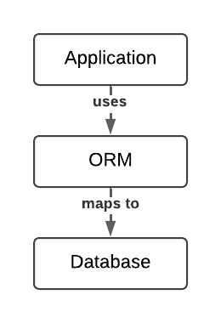
Object Relational Mapping (ORM)
ORMs provide a convenient and efficient way to interact with a database from an OOP language.
ORMs are available for a wide range of programming languages and databases
Python: Django ORM, SQLAlchemy, Peewee
Java: Hibernate, EclipseLink, MyBatis
Ruby: ActiveRecord, DataMapper, Sequel
PHP: Doctrine, CakePHP, ReadBeanPHP
.NET: Entity Framework Core, Dapper, Nhibernate
Features
Mapping the relational database model to objects
Create or update the schema to match the object model
Query the database using LINQ
Handling of transactions
Supporting different databases
ORMs also provide benefits:
Security: ORMs help to prevent SQL injection attacks by automatically escaping input data and parameterizing queries
Increased productivity: ORM reduce the amount of coded needed to interact with the database
Portability: ORM is used to abstract the underlaying database technology => changing the database without changing the code
Maintenance: changes to the database schema can be made by modifying code and executing commands rather than writing SQL scrips.

Slide 4
Entity Framework Core
Entity Framework (EF) Core is a lightweight, extensible, open source and cross-platform version of the popular Entity Framework data access technology.
EF Core can serve as an object-relational mapper (O/RM), which:
Enables .NET developers to work with a database using .NET objects.
Eliminates the need for most of the data-access code that typically needs to be written.
EF Core supports many database engines
Image by juicy_fish on Freepik
https://learn.microsoft.com/en-us/ef/core/

Slide 5
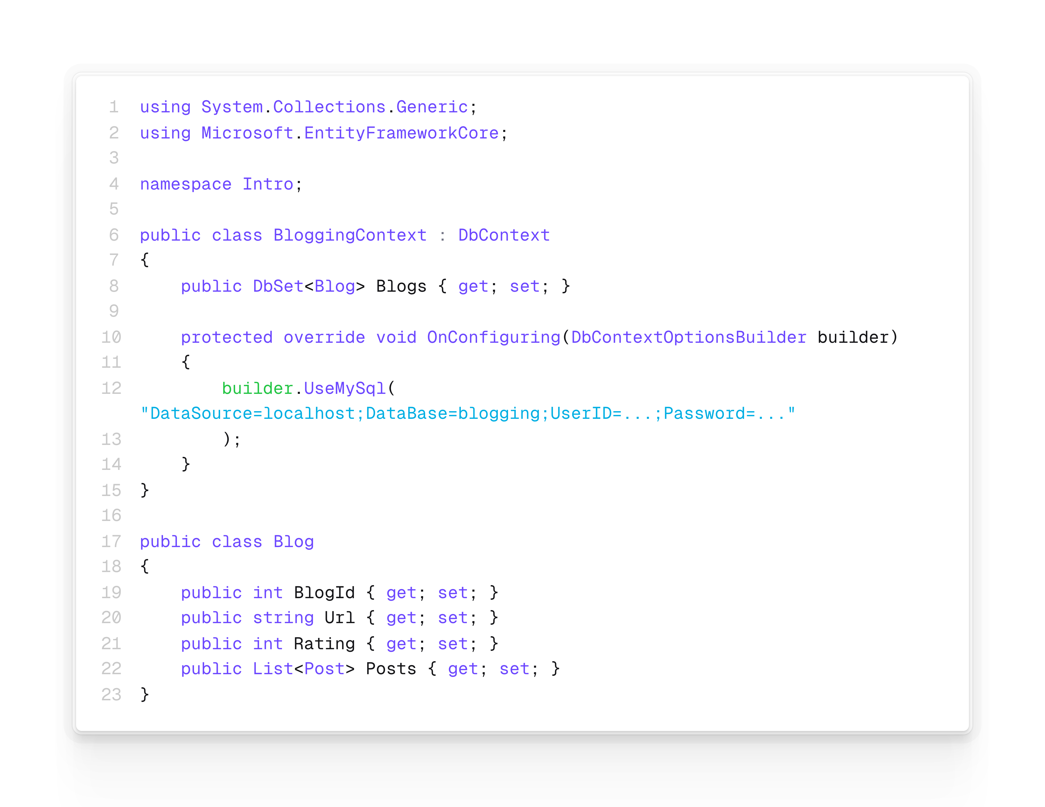
Entity Framework Core
With EF Core, data access is performed using a model. A model is made up of entity classes and a context object (DbContext) that represents a session with the database.
EF supports the following model development approaches:
Generate a model from an existing database.
Hand-code a model to match the existing database.
Use EF Migrations to create a database from the model. Migrations allow evolving the database as the model changes.
Basic example of a DbContext and model
https://learn.microsoft.com/en-us/ef/core/

Slide 6
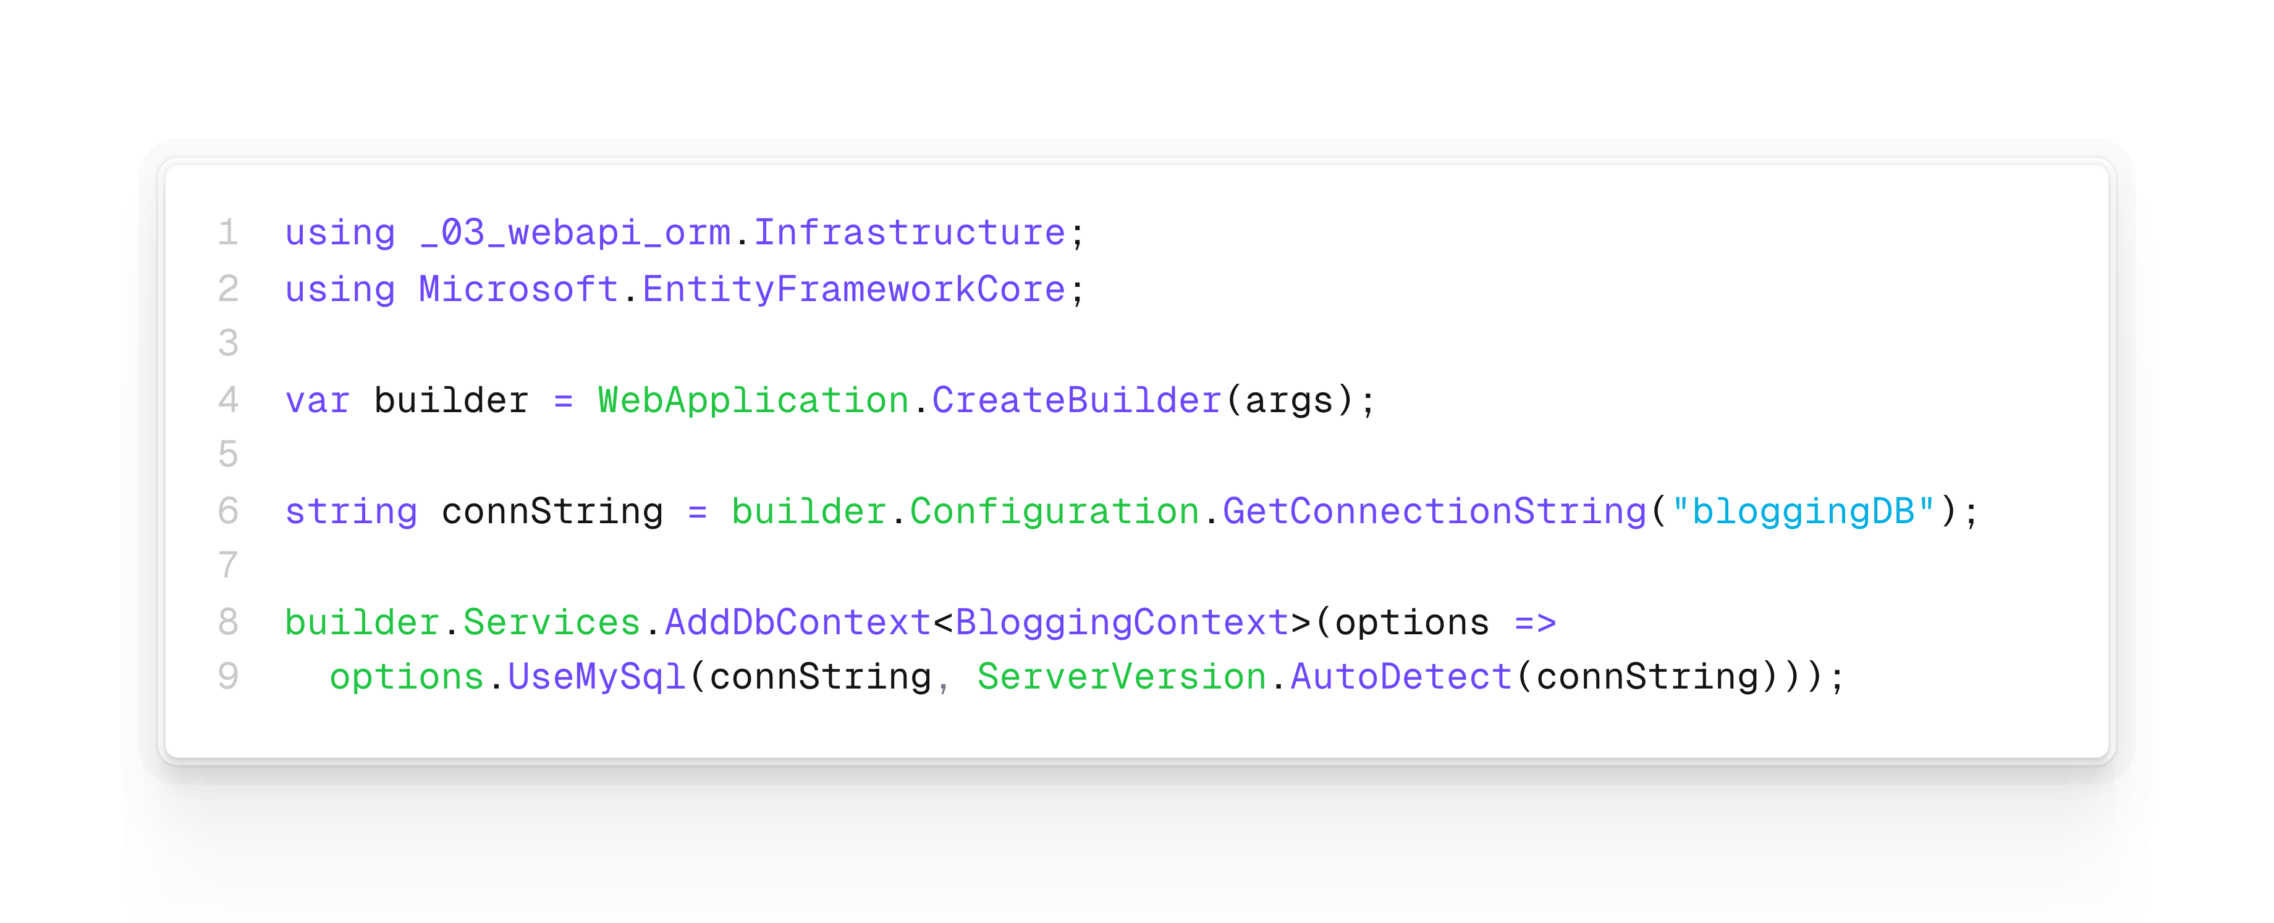
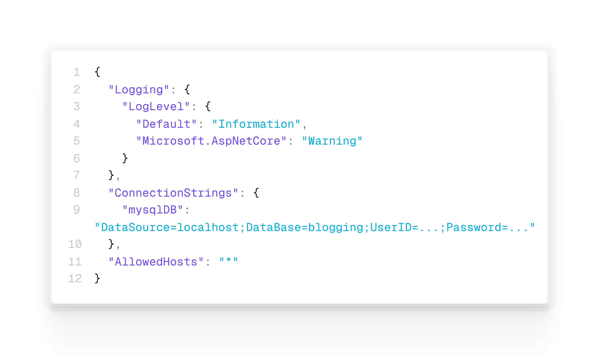
Entity Framework Core
Standard approach is to register the DbContext as Service of the IoC container such that .NET can inject it, handle creation and lifetime.
DbContext is designed to be used for a single unit-of-work. It is per default registered as scoped Service.
Database connection is usually stored in appsettings.json which can be accessed through builder.Configuration
Program.cs
appsettings.json
https://learn.microsoft.com/en-us/ef/core/

Slide 7
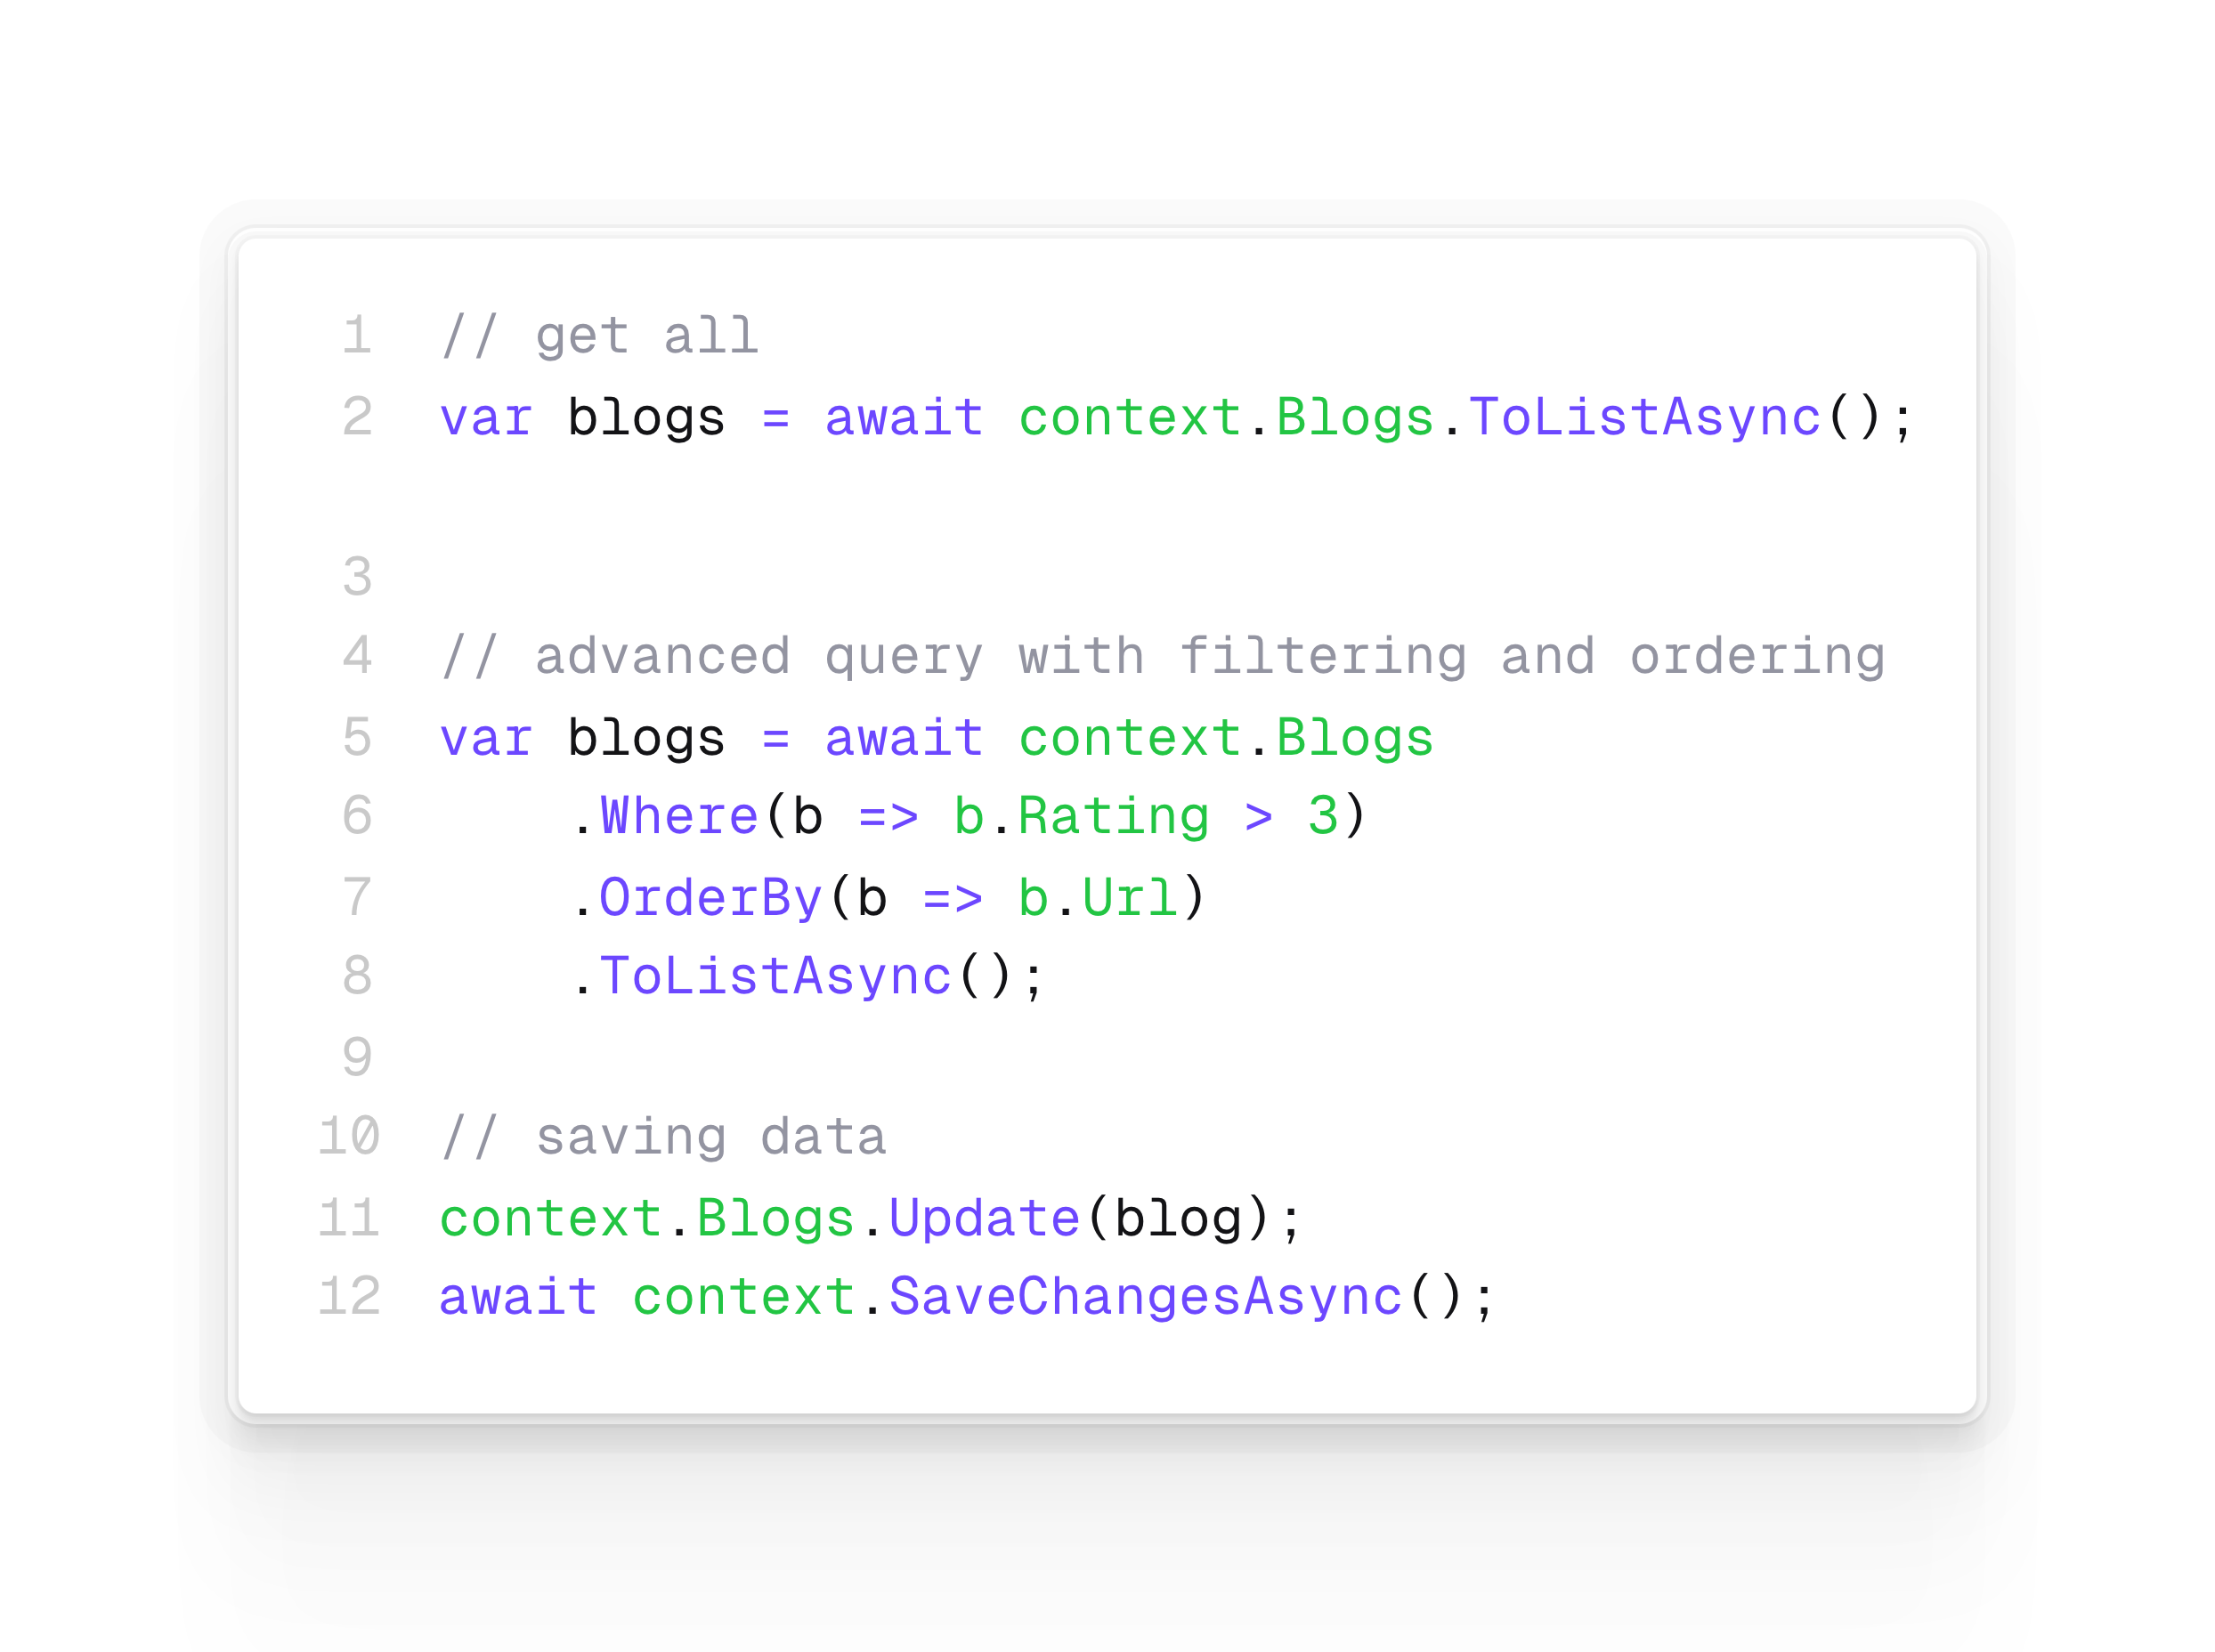
Interacting with DbContext
Entity Framework Core uses Language-Integrated Query (LINQ) to query data from the database.
EF Core passes a representation of the LINQ query to the database provider
Database providers in turn translate it to database-specific query language (for example, SQL for a relational database)
Entities are accessible through DbSet properties of DbContext
With LINQ queries you can load all, load by id or simply filter entities
Usually the async query methods are used as the execution of a LINQ query is probably an expensive operation
https://learn.microsoft.com/en-us/ef/core/querying/

Slide 8
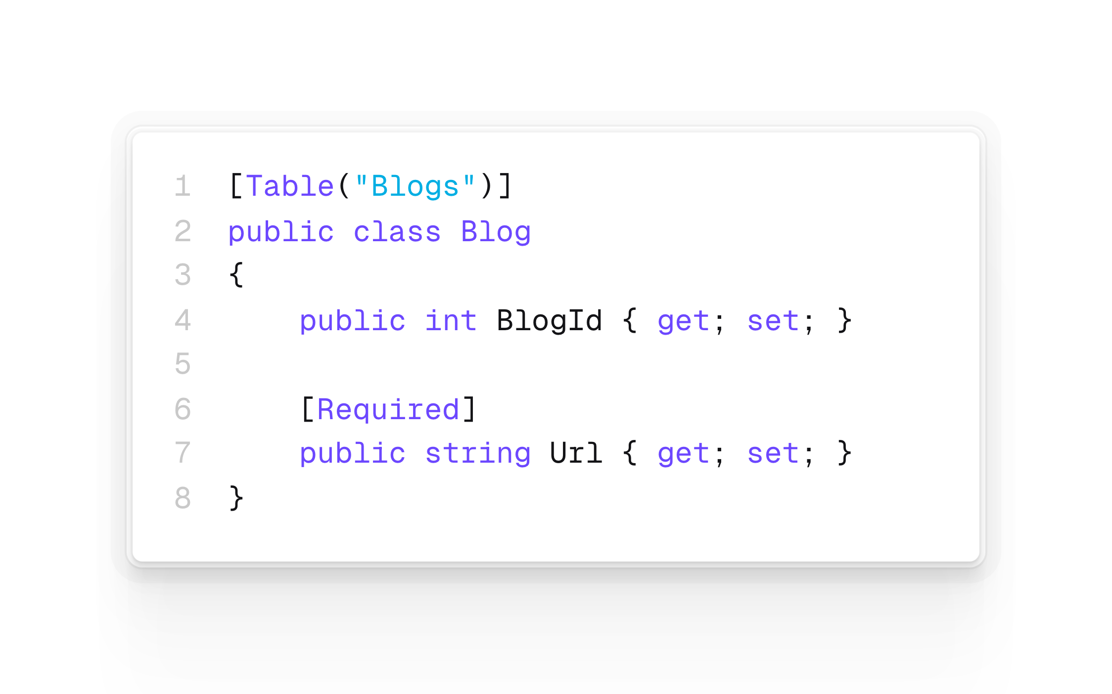
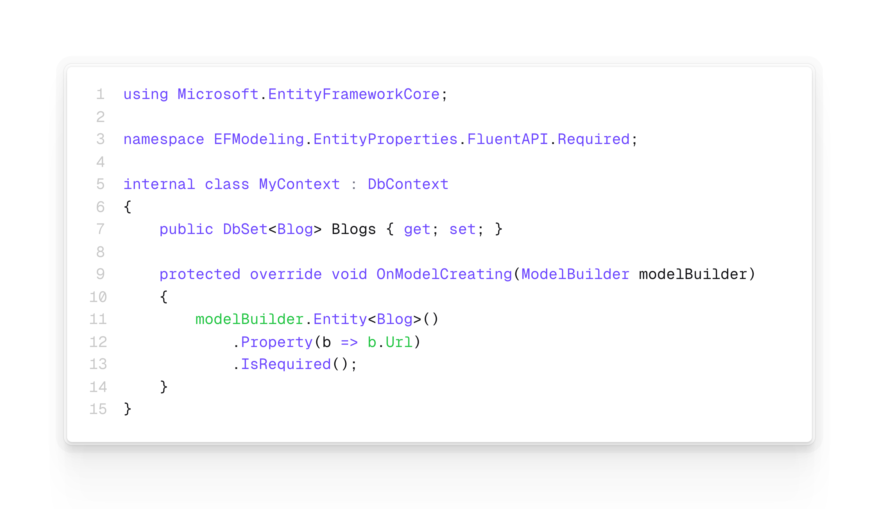
Creating and configuring a model
EF Core uses a metadata model to describe how the application's entity types are mapped to the underlying database using a set of conventions - heuristics that look for common patterns.
Conventions for models can be customised/overwritten
by using mapping attributes (also known as data annotations)
calls to the ModelBuilder methods (also known as fluent API)
Model configuration with annotations
Model configuration with fluent API
https://learn.microsoft.com/en-us/ef/core/modeling

Slide 9
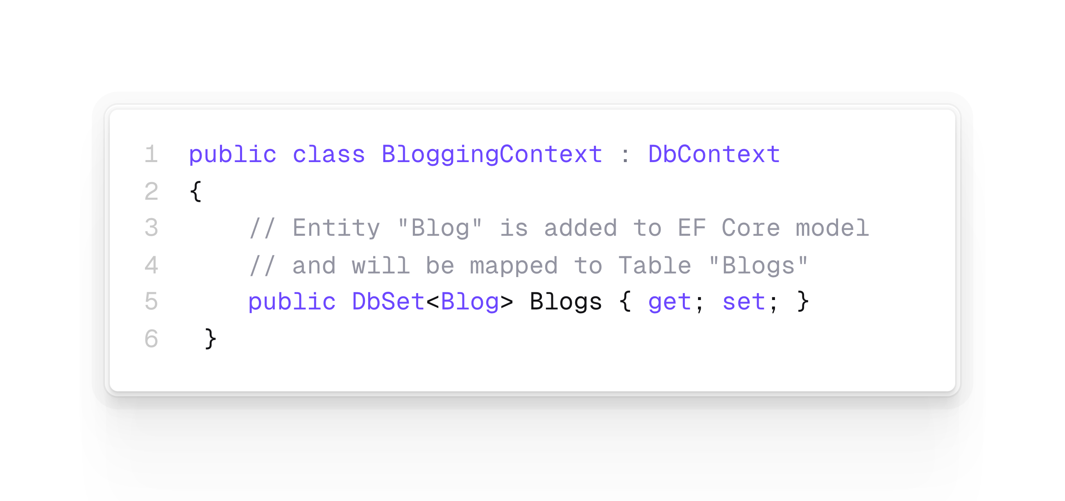
Entity types conventions
Including a DbSet of a type on your context means that it is included in EF Core's model
Alternatively a type may be included if it was discovered via a navigation property of an already included type (see later)
Types can be excluded if they should not be mapped to the database
Each entity type will be set up to map to a database table with the same name as the DbSet property that exposes the entity (fallback is entity class name)
Of course it can be manually overwritten
https://learn.microsoft.com/en-us/ef/core/modeling

Slide 10
Model properties conventions
all public properties with a getter and a setter will be included in the model
using a relational database
entity properties are mapped to table columns having the same name as the property
the database provider selects a data type based on the .NET type of the property
A property is considered optional if it is valid for it to contain null. Otherwise it is considered to be a required.
Required: int, decimal, bool, etc.
Optional: int?, decimal?, bool?, etc.
Entity Framework does not do any validation of maximum length before passing data to the provider. It is up to the provider or data store to validate if appropriate.
https://learn.microsoft.com/en-us/ef/core/modeling

Slide 11
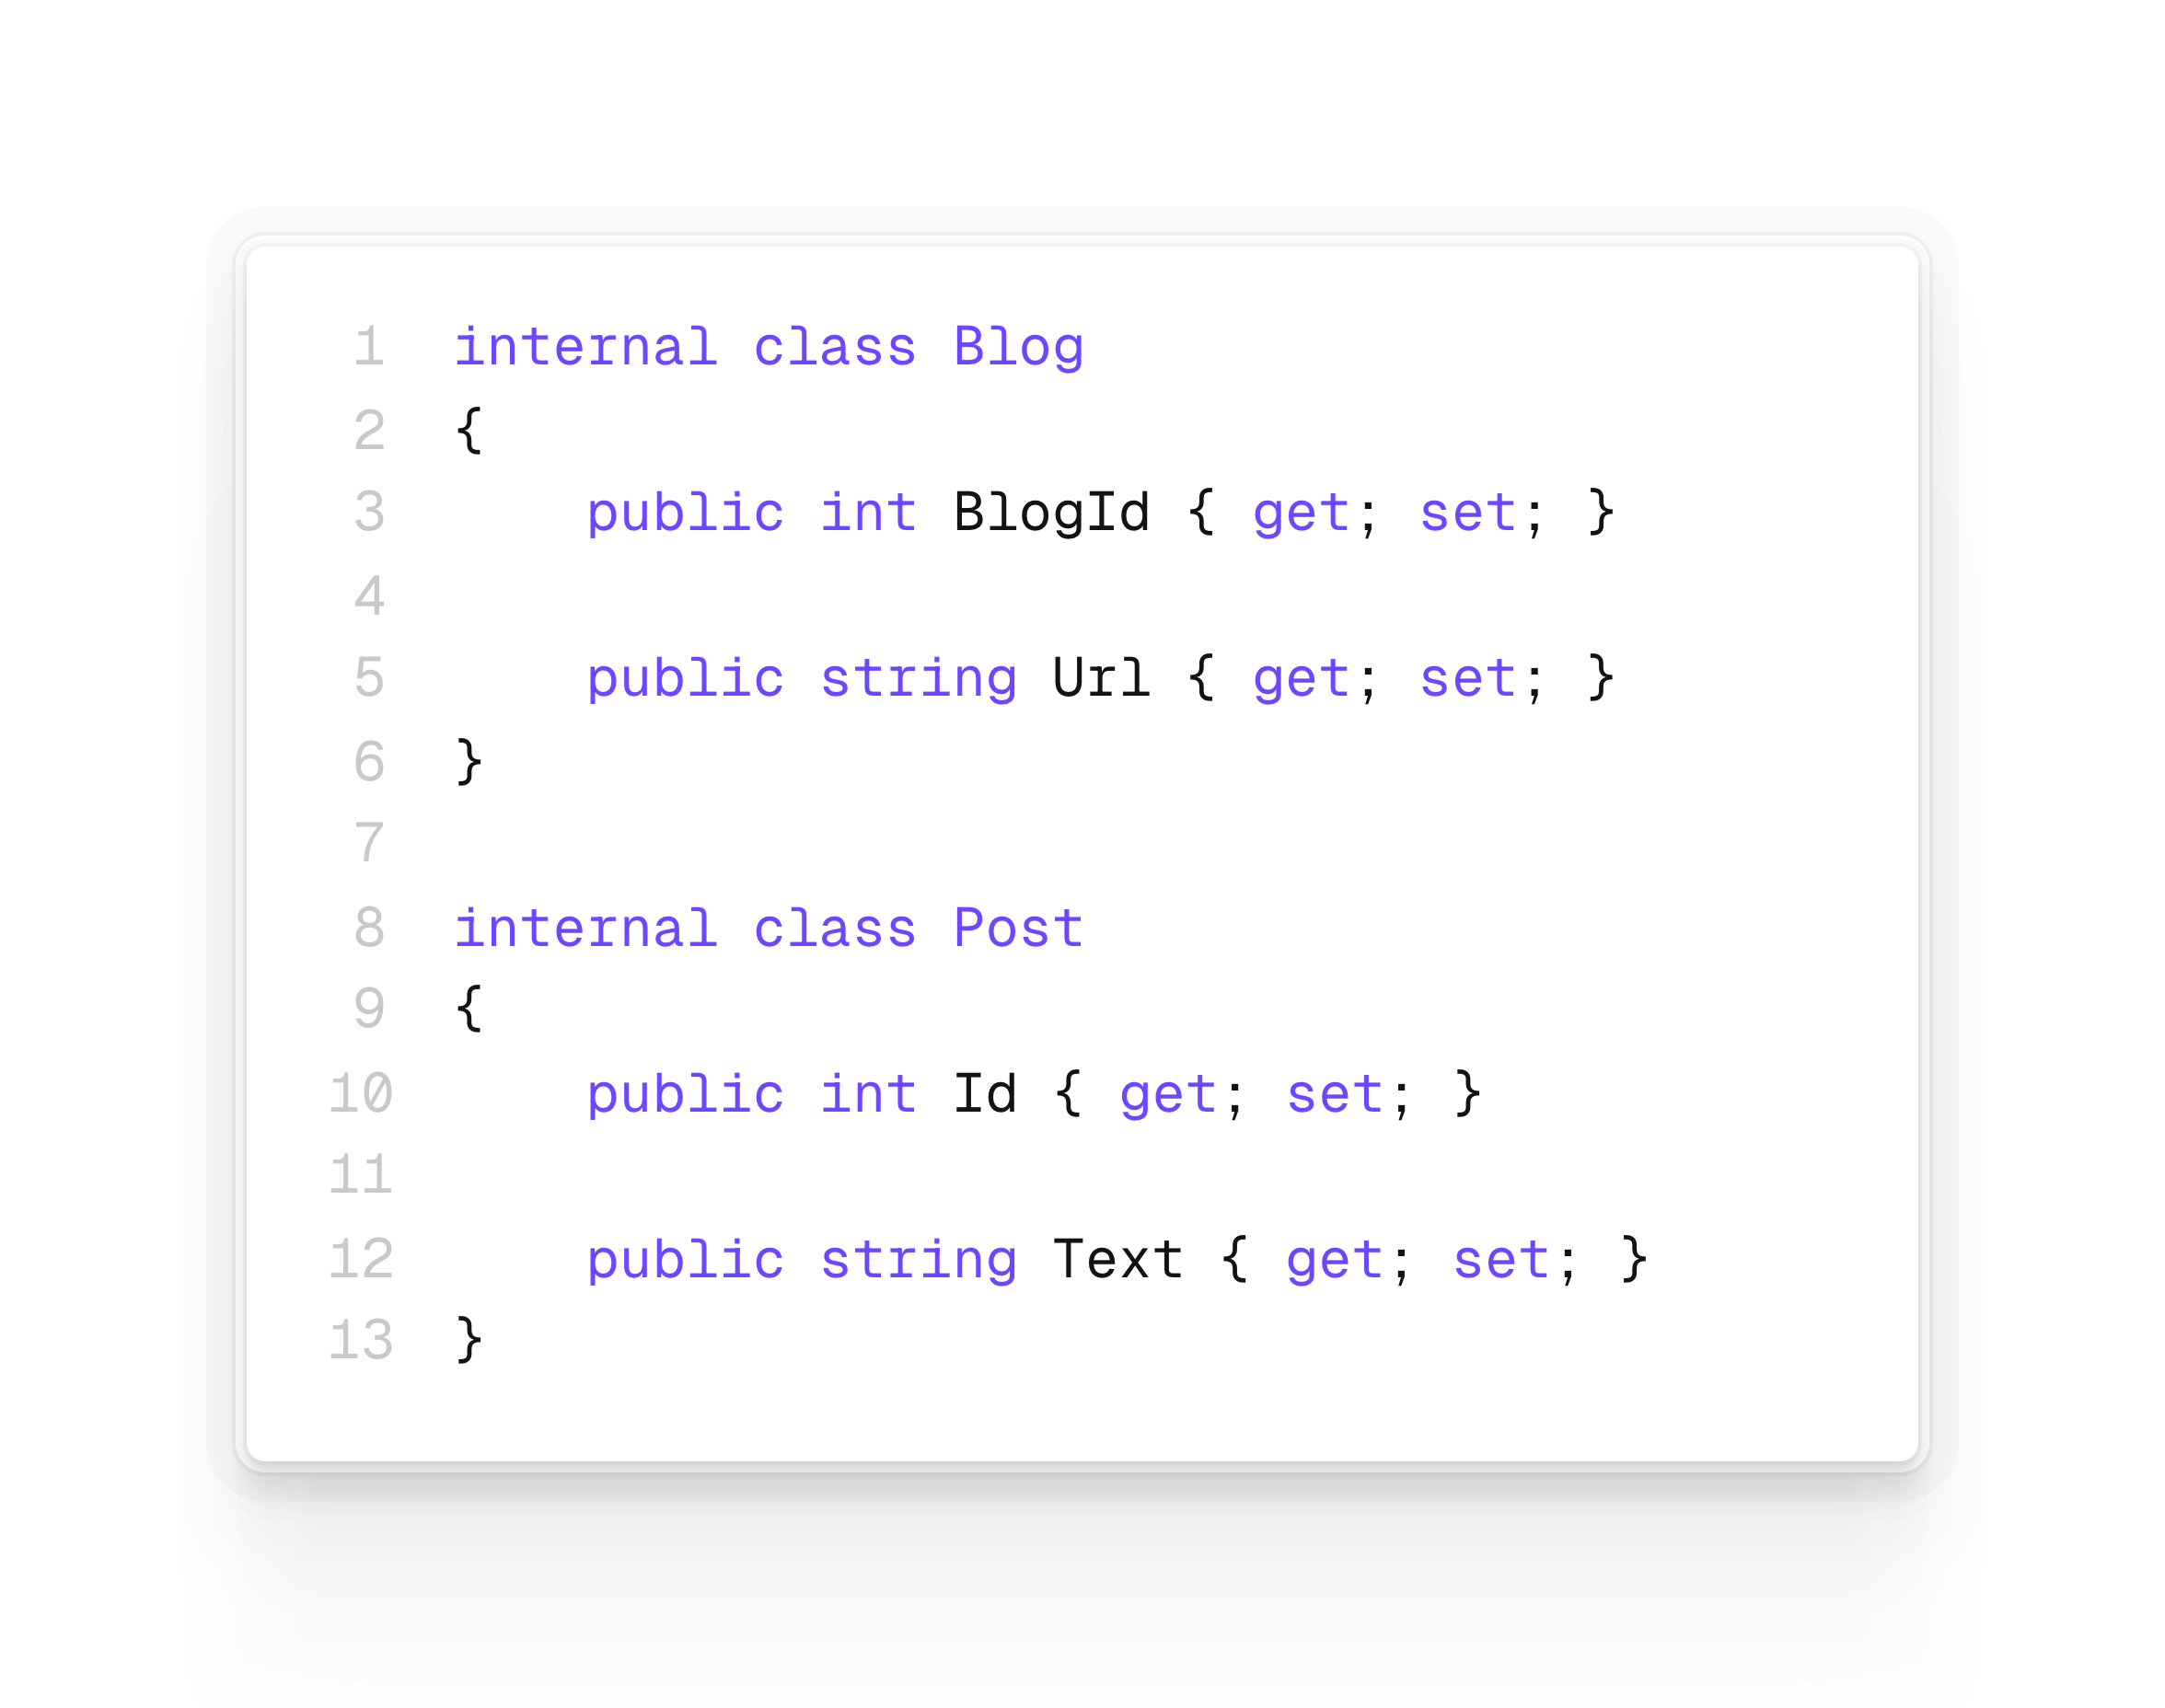
Entity keys
A key serves as a unique identifier for each entity instance. Most entities in EF have a single key, which maps to the concept of a primary key in relational databases
By convention, a property named Id or <type name>Id will be configured as the primary key of an entity.
Of course you can specify any property to be a key with annotations or by using the fluent API
Primary keys of type short, int, long, or Guid are set up to have values generated for inserted entities if a value isn't provided by the application.
https://learn.microsoft.com/en-gb/ef/core/modeling/keys

Slide 12
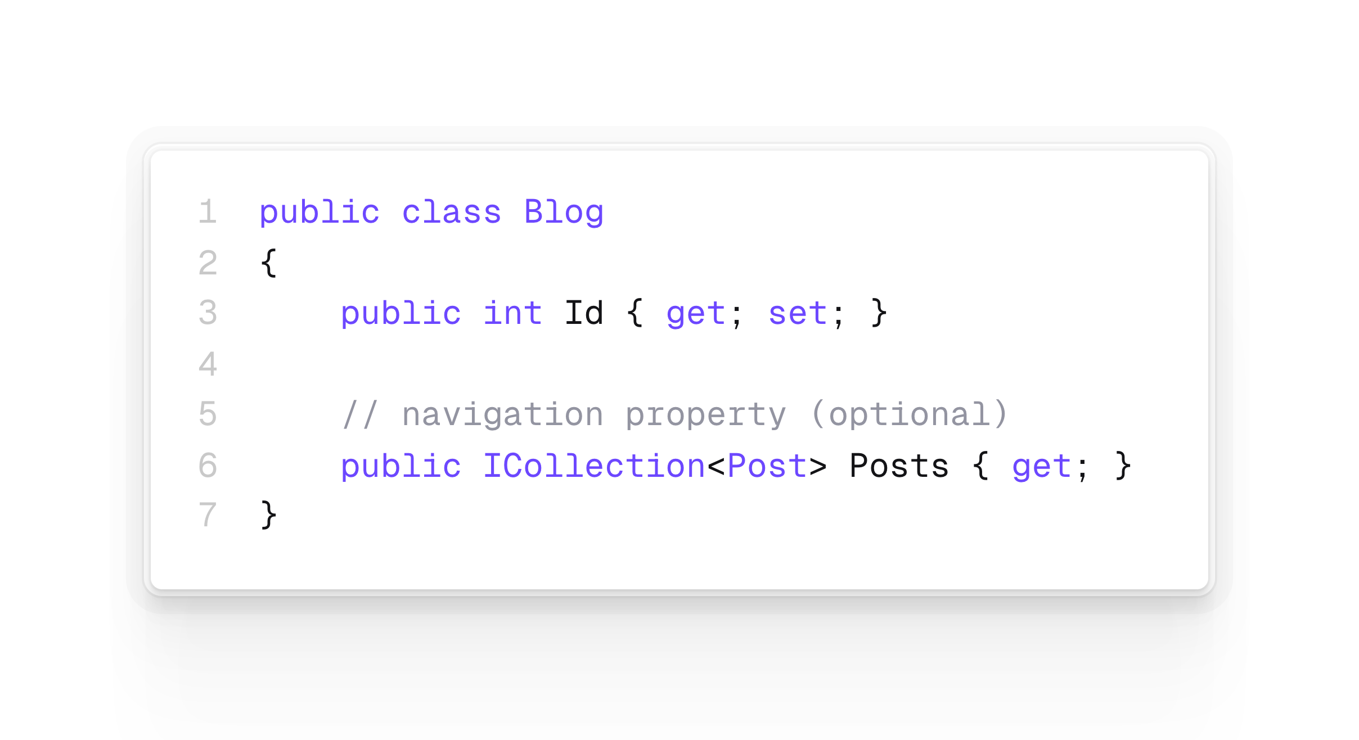
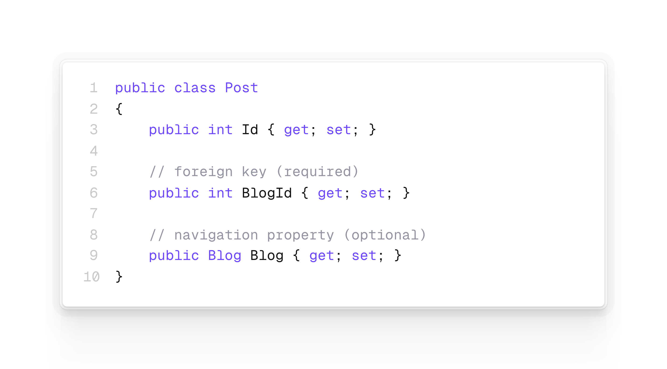
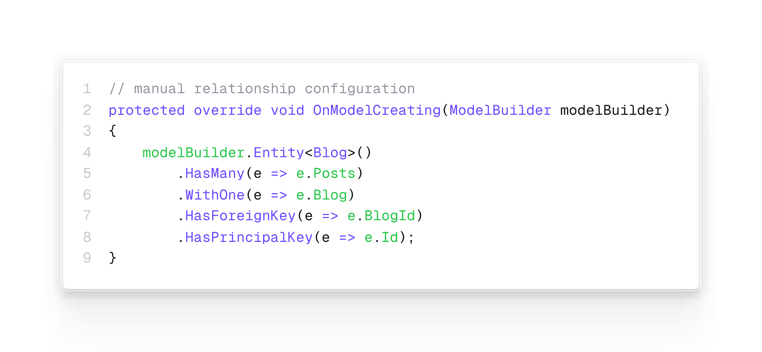
Entity relationships
Mapping relationships in EF Core involves in the most basic sense:
Adding a primary key property to each entity type.
Adding a foreign key property to one entity type.
Associating the references between entity types with the primary and foreign keys to form a single relationship configuration.
Again EF Core detects foreign keys by convention. As always it is possible to manually configure the relationship.
In order to be able to navigate from one entity to the other of a relationship there can be (optionally) added a so called “navigation property”.
https://learn.microsoft.com/en-gb/ef/core/modeling/relationships

Slide 13
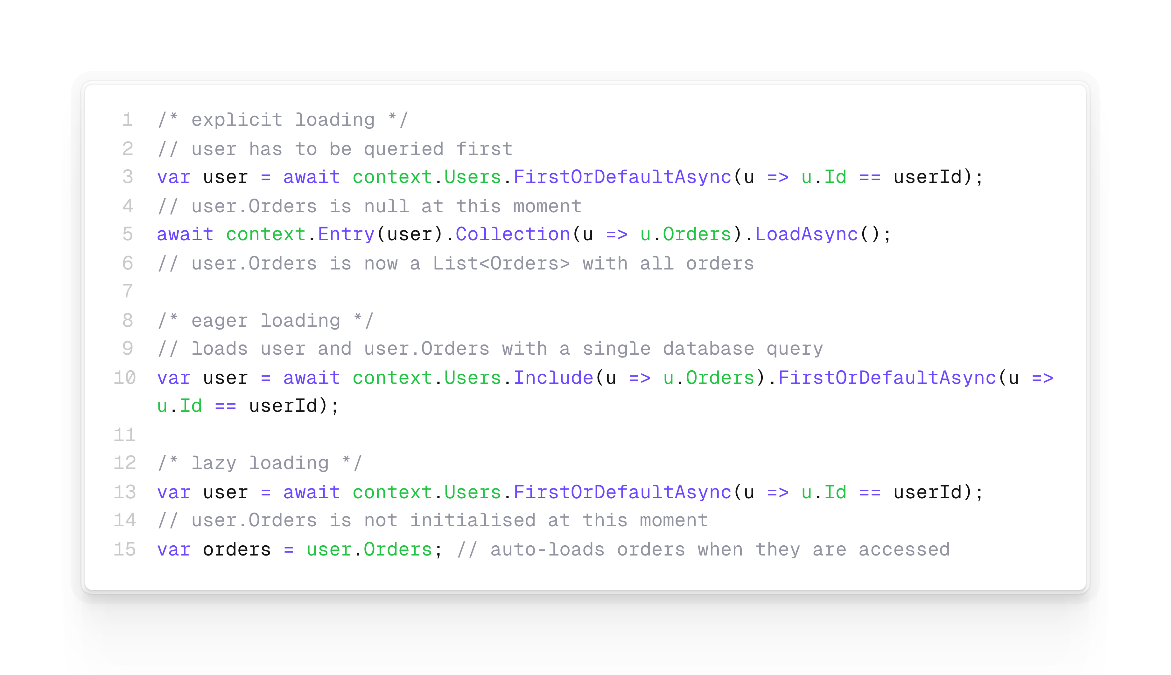
Entity relationships
EF Core allows to use the navigation properties to load related entities
Eager Loading: loading the data in the initial query => may cause performance issues and resolves relationship even if not needed
Explicit Loading: means the data is loaded later using an explicit method call => needs multiple database calls
Lazy Loading: data of navigation properties are loaded when the property is accessed => most comfortable approach, but with serious downsides (unneeded extra database roundtrips, performance issues). Be aware: This approach requires proxies and must be activated using UseLazyLoadingProxies.
https://learn.microsoft.com/en-gb/ef/core/modeling/relationships

Slide 14
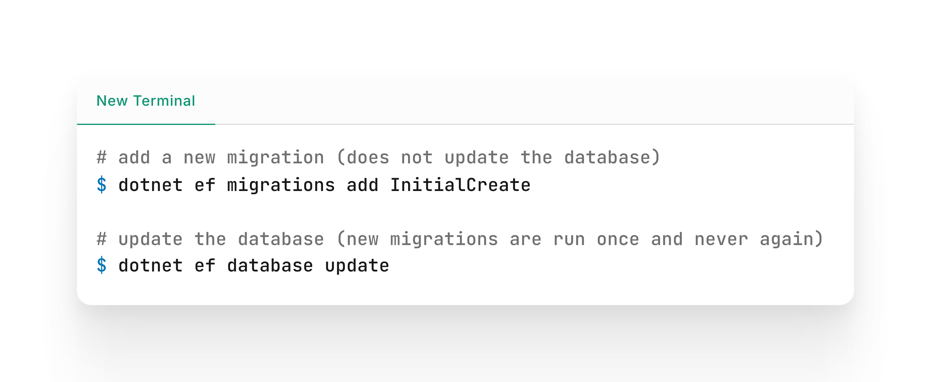
Migrations
EF Core will not automatically alter the underlaying database. If database schema and EF Core model do not match it runs into an error.
To solve this a migration can be generated based on the EF Core model that is then run once to alter the database to match the EF Core model.
Whenever the EF Core model changes (throughout the application lifetime for example as part of a new feature) a new migration can be generated and run.
https://learn.microsoft.com/en-us/ef/core/managing-schemas/migrations

Slide 15
Web API incl. ORM

Slide 16
Application architecture DTOs, POCOs & value objects
Plain Old CLR Objects (POCO) are domain objects. They are
persistent-ignorant => but may be persisted by data access layers and
implement only domain business logic that means they include the data AND validation logic
Data Transfer Objects (DTO) are a lightweight version of POCOs, because they are
containers for data and used for
passing data between layers / services and
do not contain any method / logic => transfer data without behaviour!
Value objects are like POCOs, but without any identity and represent an aspect of the domain
https://enterprisecraftsmanship.com/posts/dto-vs-value-object-vs-poco/

Slide 17
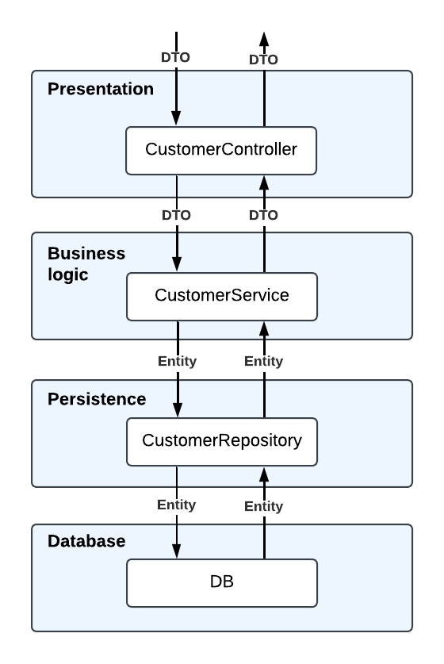
Application architecture Services, Repositories, Entities and DTOs together
In a Layered Architecture the layers may be separated using Services and Repositories
CustomerController: implement use cases (cancelOrder, addArticleToBasket, proceedToCheckout,, …), is responsible for validation and uses Services and or Repositories to persist data
CustomerService: Triggers further actions (e.g. proceedToCheckout), maps the DTOs into entities and uses the repositories for their persistence.
CustomerRepository: responsible for persisting data.
Advantages and Disadvantages
Layer are isolated, but every Layer has a direct dependency on a layer below
Separation of concern, but changes to one layer require redeplayment of the whole app
Layers can be independently implemented and tested
Source: https://medium.com/java-vault/layered-architecture-b2f4ebe8d587

Slide 18
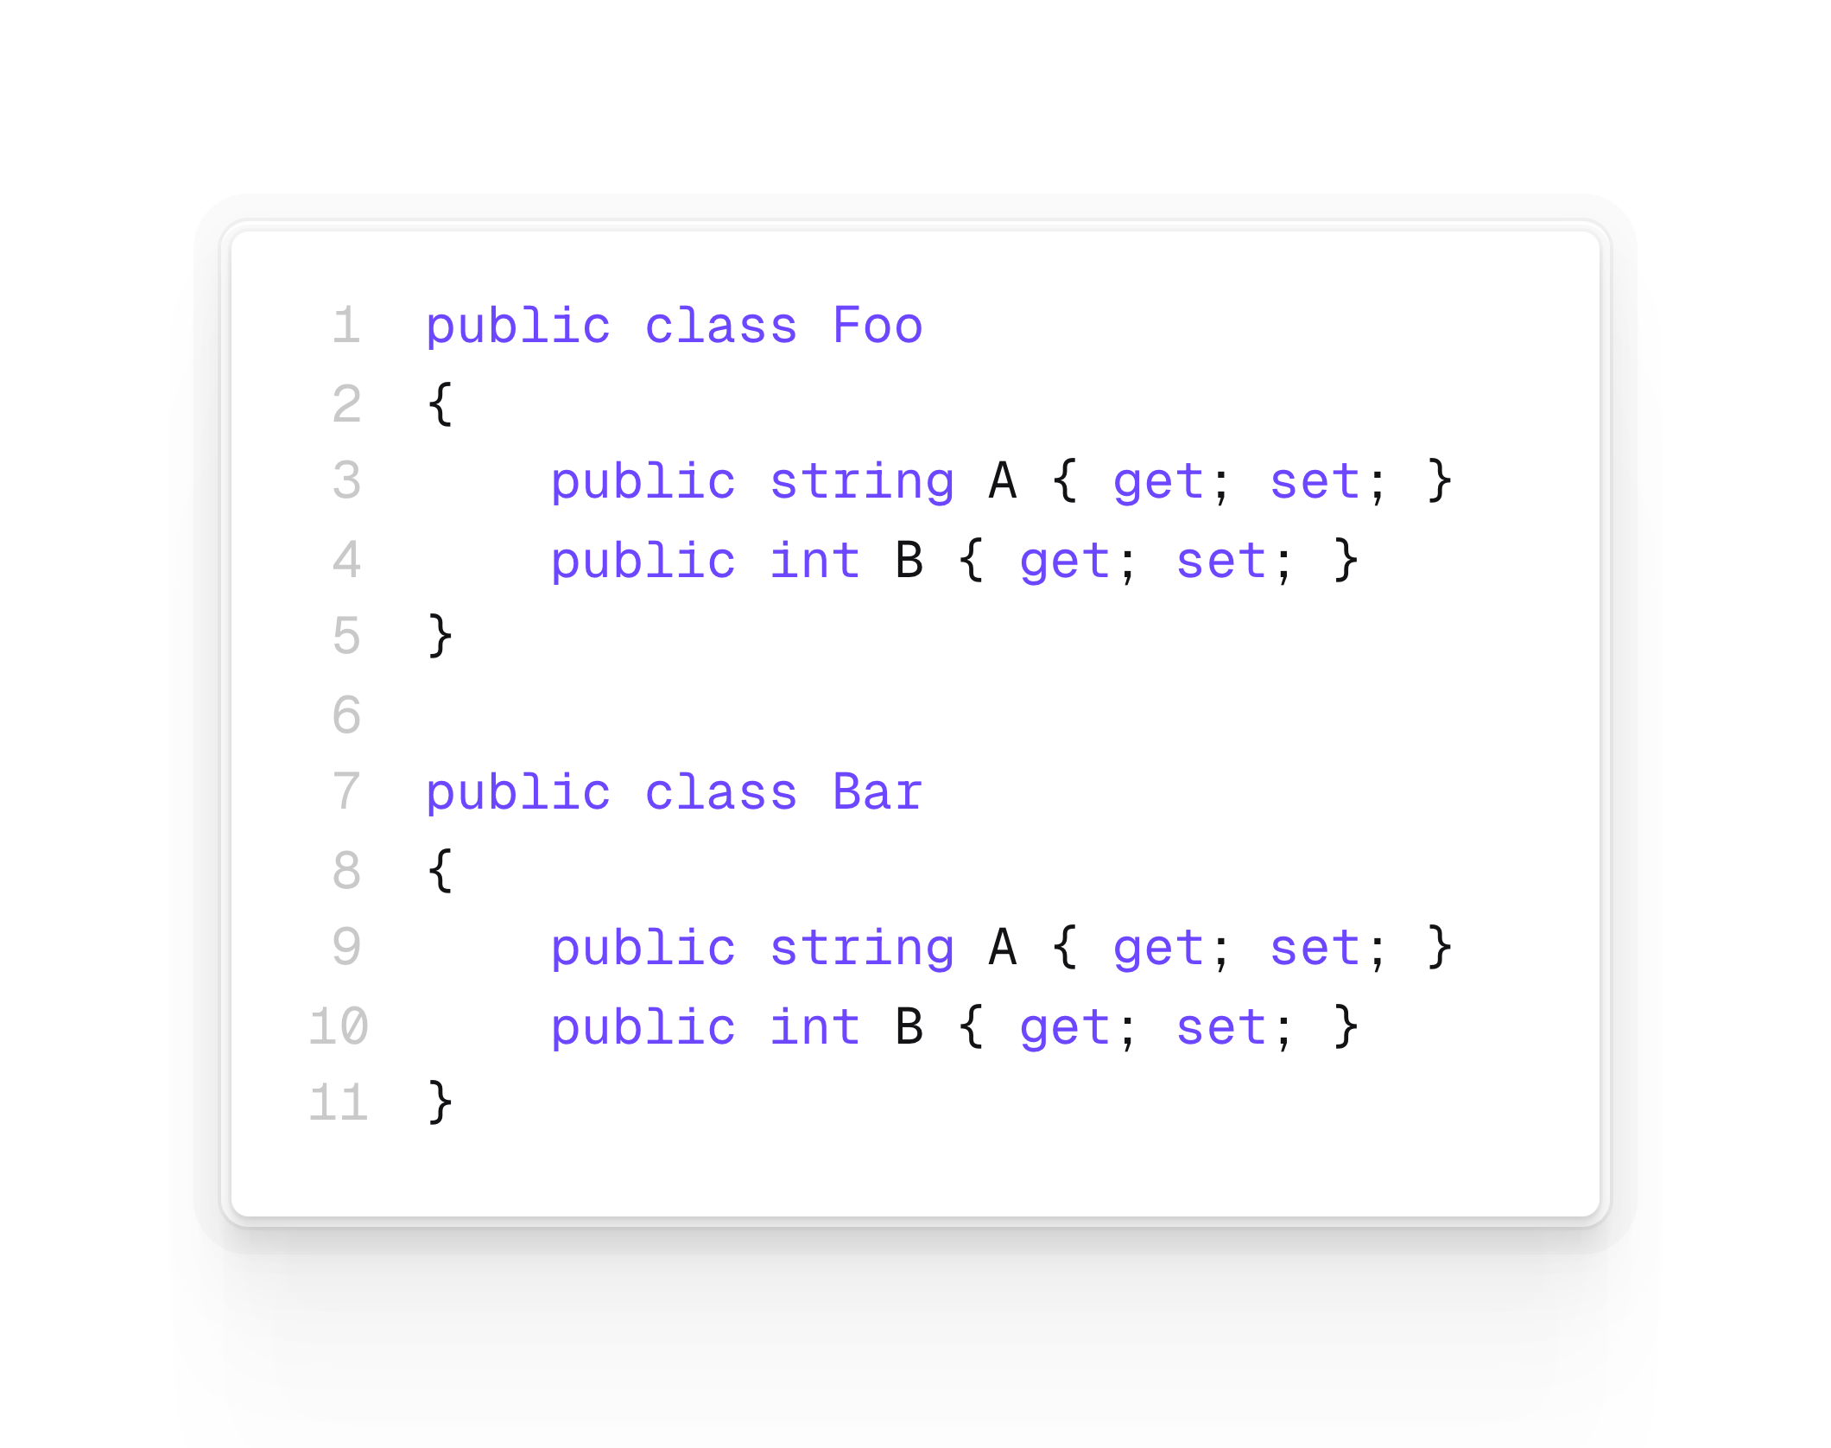
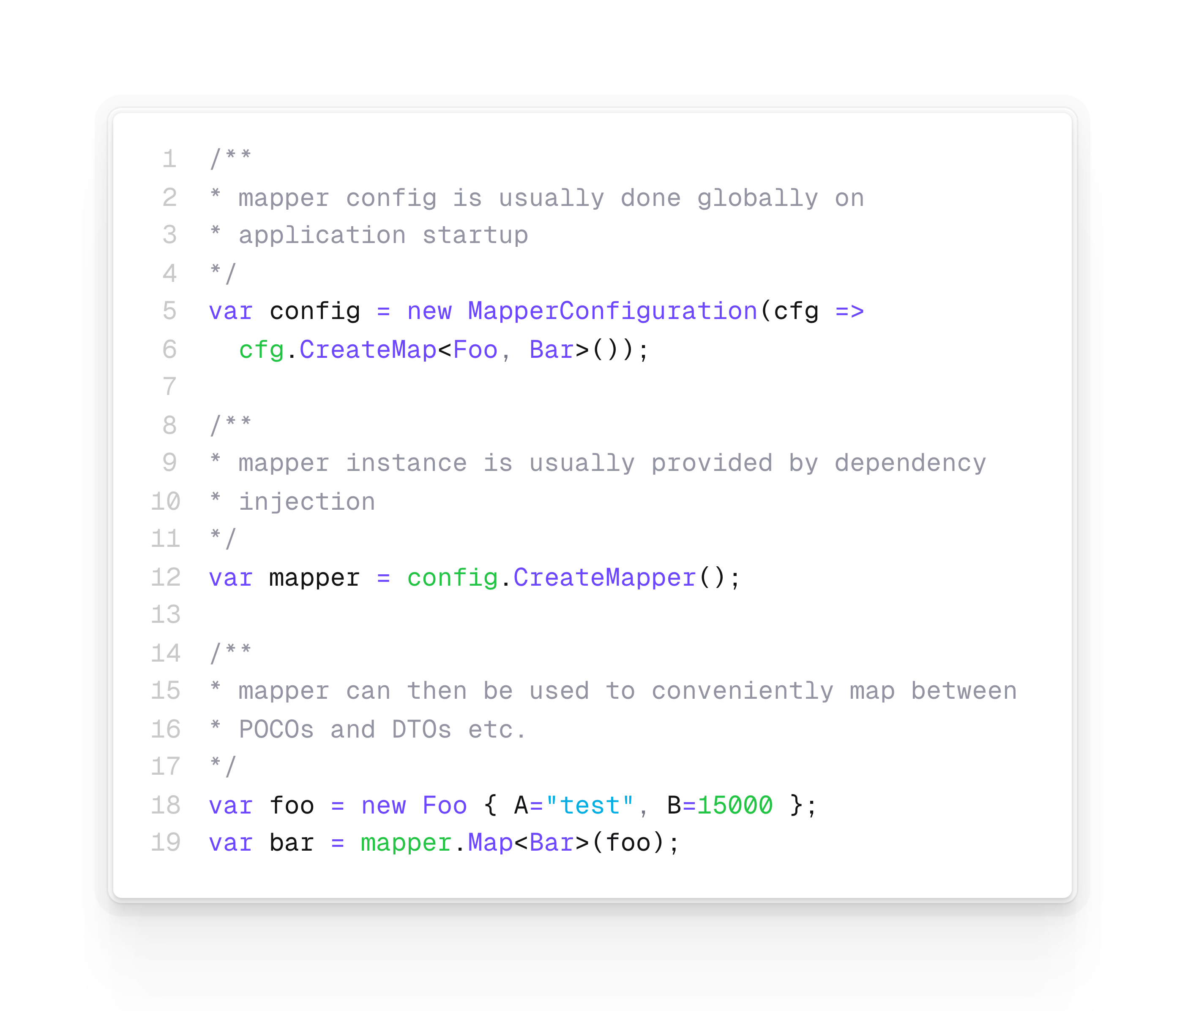
Using Automapper to map between Entities and DTOs
In order to avoid writing repetitive code to map from one representation into another there are tools that can be used like Automapper
https://docs.automapper.org/en/latest/Getting-started.html
https://enterprisecraftsmanship.com/posts/dto-vs-value-object-vs-poco/

Slide 19

Standard approach to setup a Web API incl. ORM
Create an ASP.Net Core Wep API project
EF Core
Install required packages (NuGet or PM Console)
Create entity classes
Create DbContext class
Add connection string to appsettings.json
Add DbContext as a service in Program.cs
Generate and execute a migration
See exercise project on GitHub for reference (code example)
Web API
Create a controller class
Add controllers as service in Program.cs
Map controller routes in Program.cs
Use DbContext via Dependecy Injection in controller or introduce a Respository as a layer of abstraction

Slide 20
ADO.Net

Slide 21
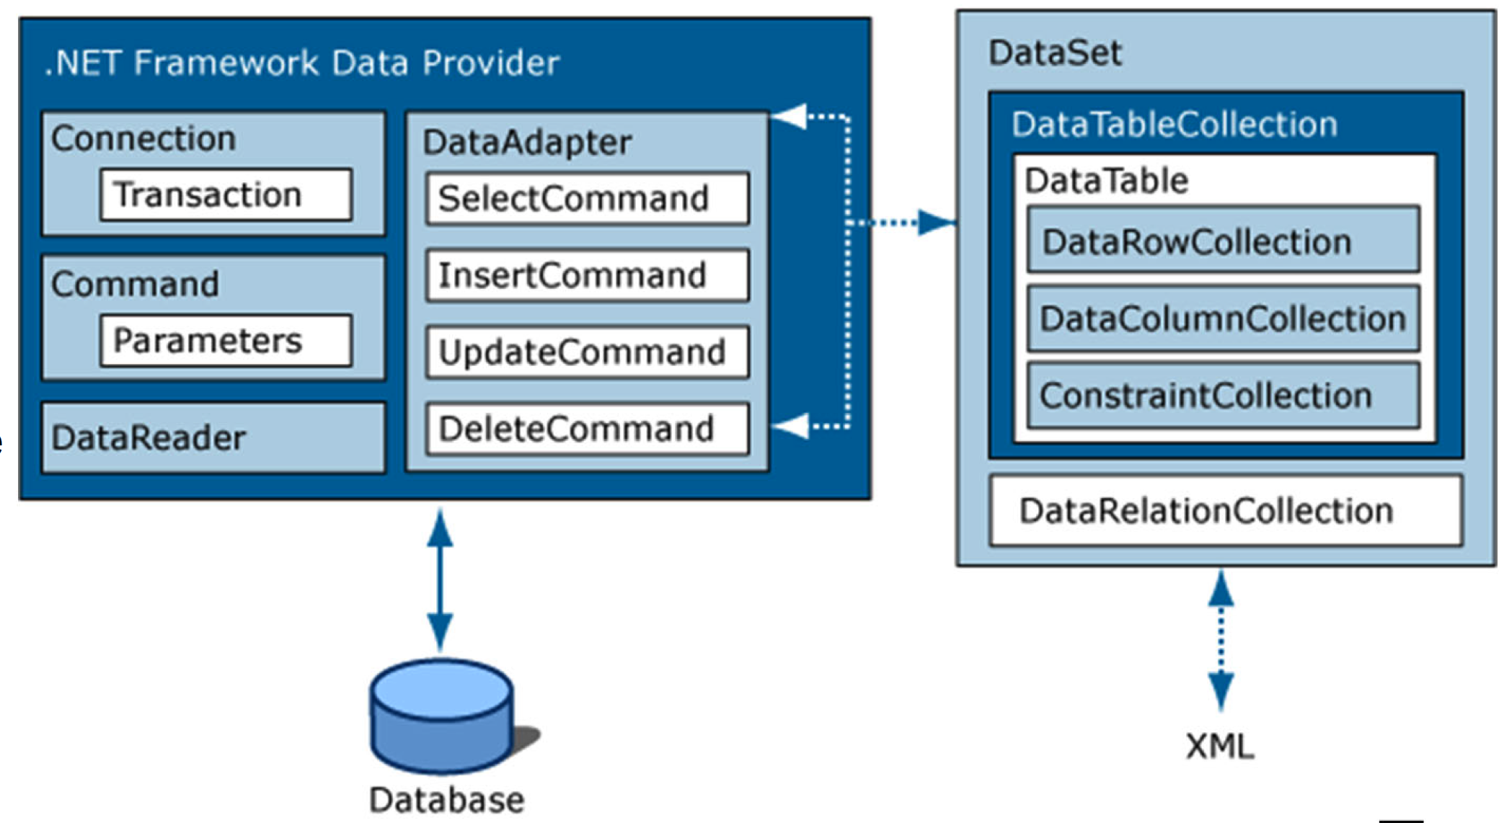
ADO.Net Purpose and Components
ADO.Net is a data-access technology that enables application to connect to datastores and manipulate data
ADO.Net is an object oriented framework that allows to interact with database systems. Core Components are:
Connection: establishes a connection to DB
Command: execute SQL queries/manipulate
DataReader: retrieve data from a database
DataAdapter: retrieve data from a data source and populate tables within a DataSet
DataSet: in-memory representation of data
ADO.Net interacts with the database = data access / persistance / infrastructure layer
Source: https://www.c-sharpcorner.com/uploadfile/puranindia/what-is-ado-net/
https://learn.microsoft.com/en-us/dotnet/framework/data/adonet/ado-net-overview

Slide 22
ADO.Net Package & Steps
The ADO.NET classes are found in System.Data.dll and there are specific providers for different database systems: e.g. MySql.Data (installable as NuGet package)
Steps do develop an application based on ADO.Net:
Setup database
Create a table for each model (entity)
Create a column for each property
Configure primary and foreign keys
Configure indexes, if not already done automatically
Create entity classes
Create data access class
Use data access class to retrieve and manipulate data

Slide 23
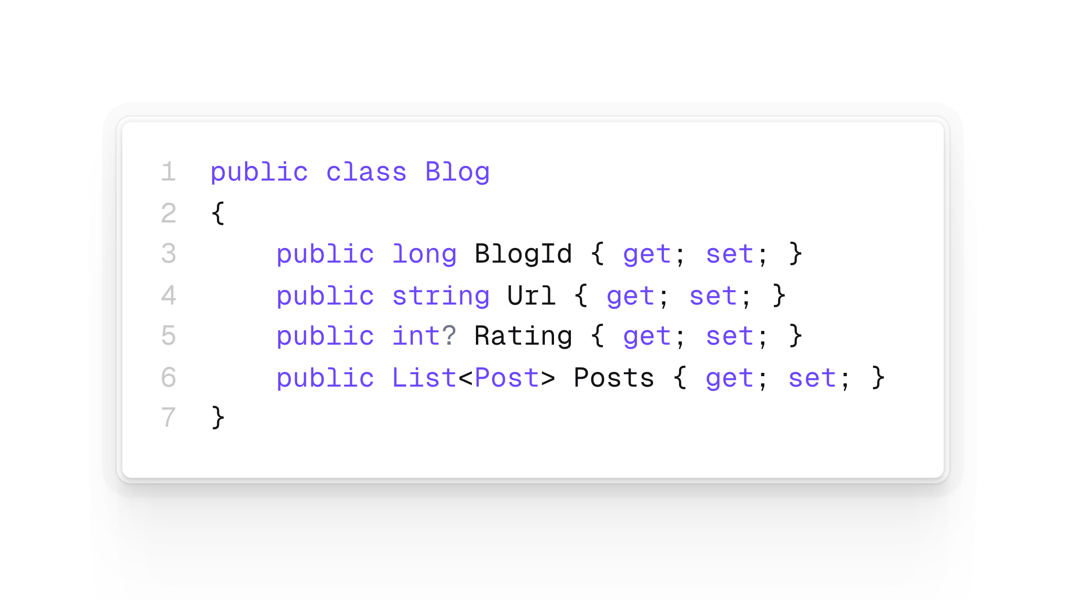
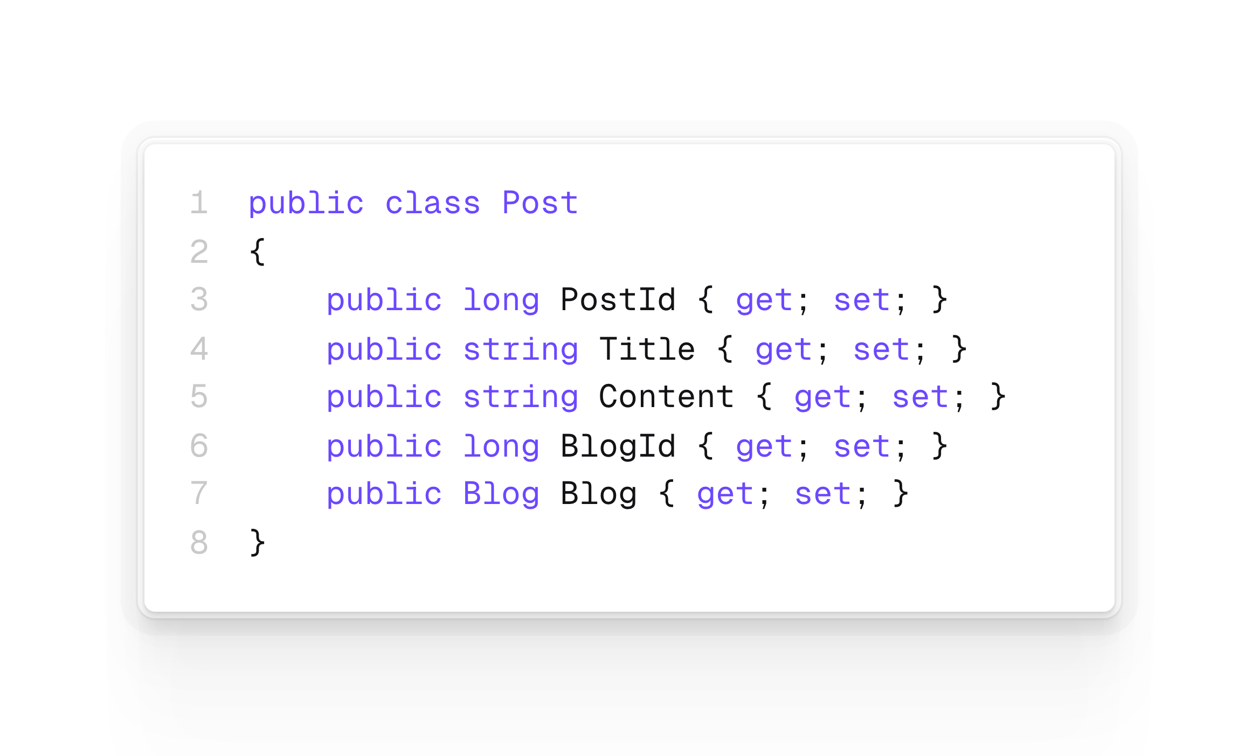
ADO.Net code example: Entity classes

Slide 24
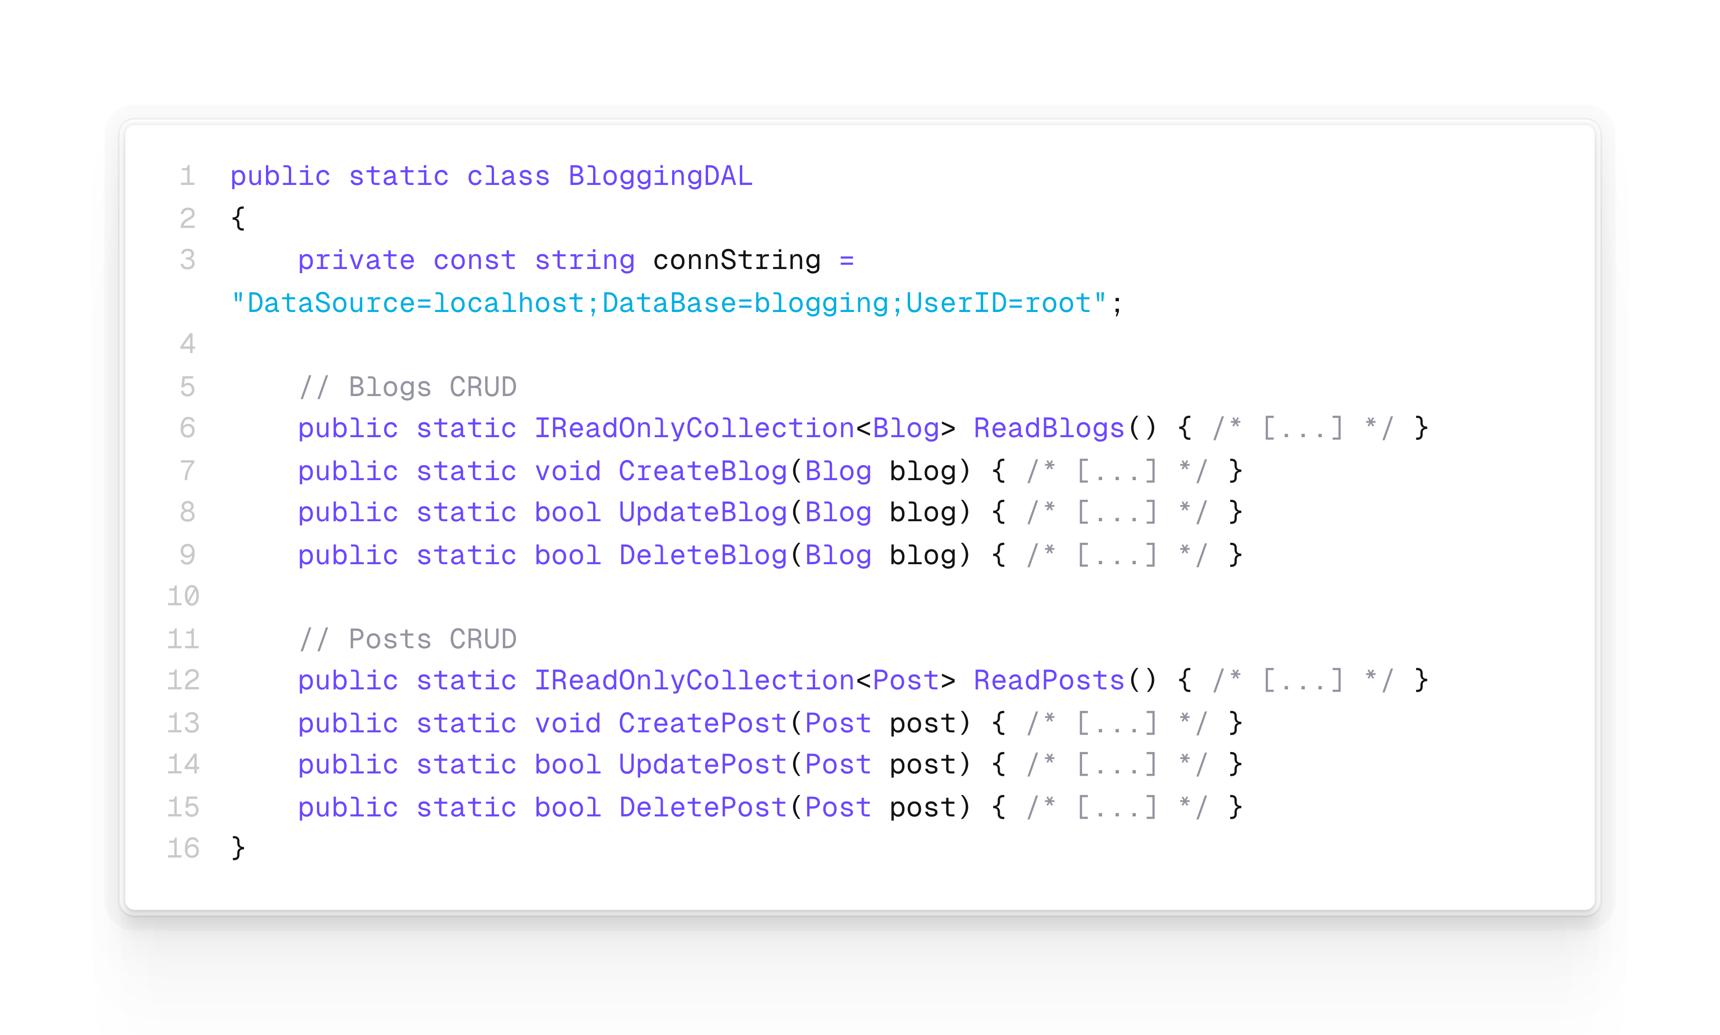
ADO.Net code example: Data access class (Data Access Layer = DAL)

Slide 25
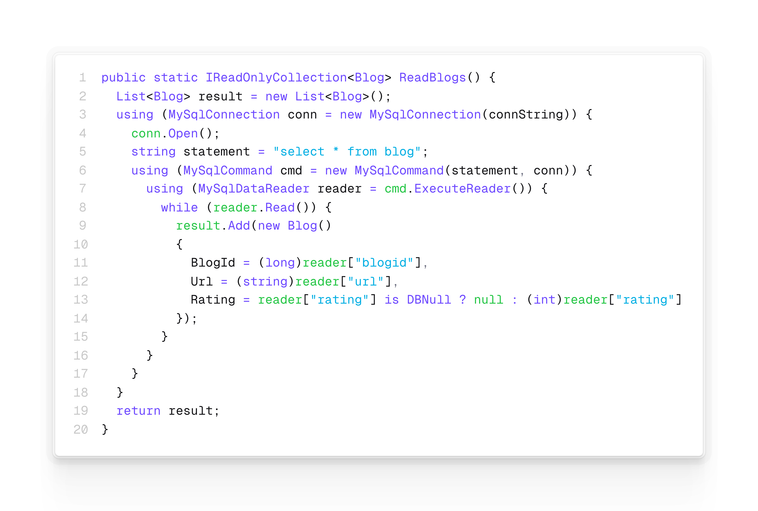
ADO.Net code example: DAL Read Blogs
Connection
Command
DataReader

Slide 26
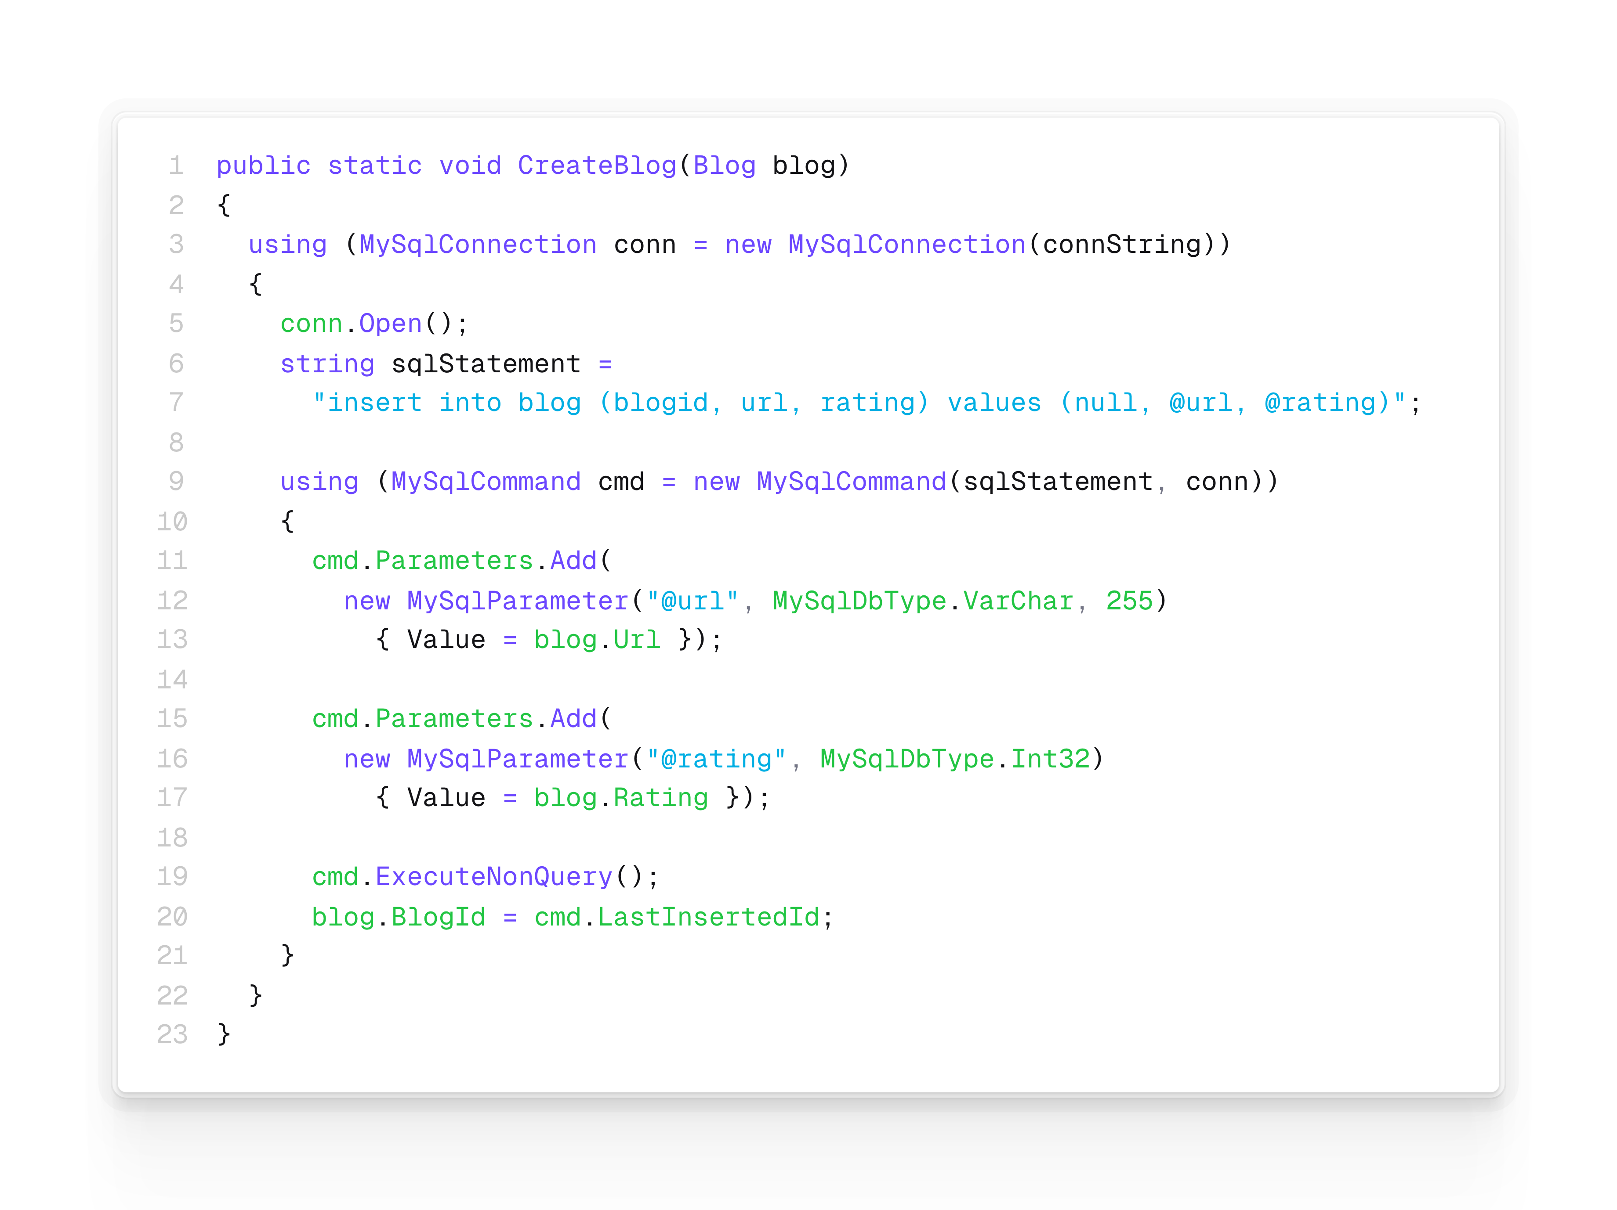
ADO.Net code example: DAL Create Blog

Slide 27
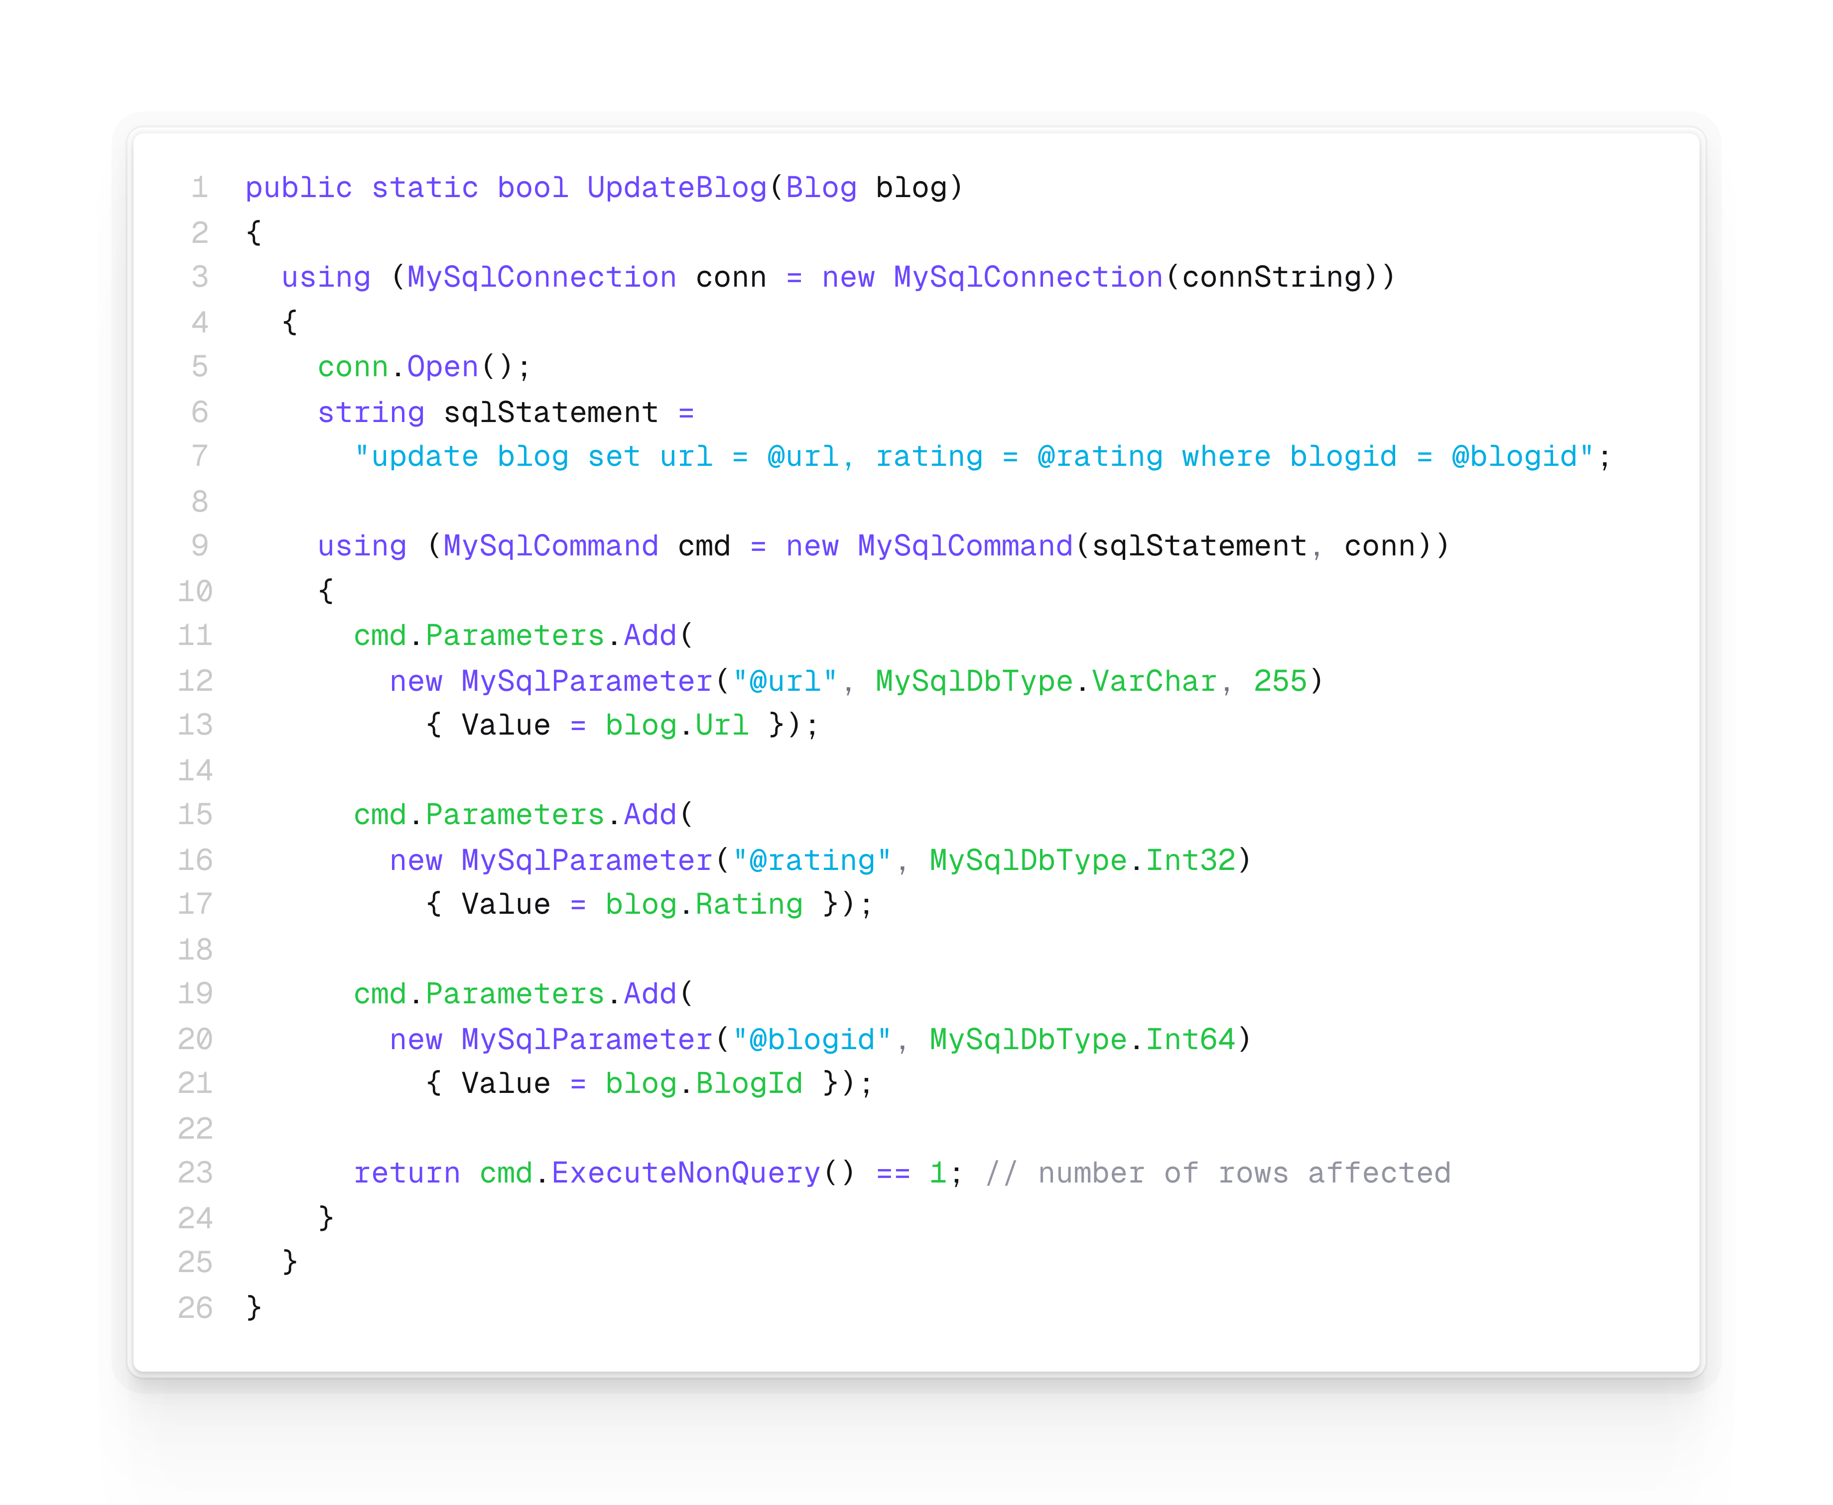
ADO.Net code example: DAL Update Blog

Slide 28
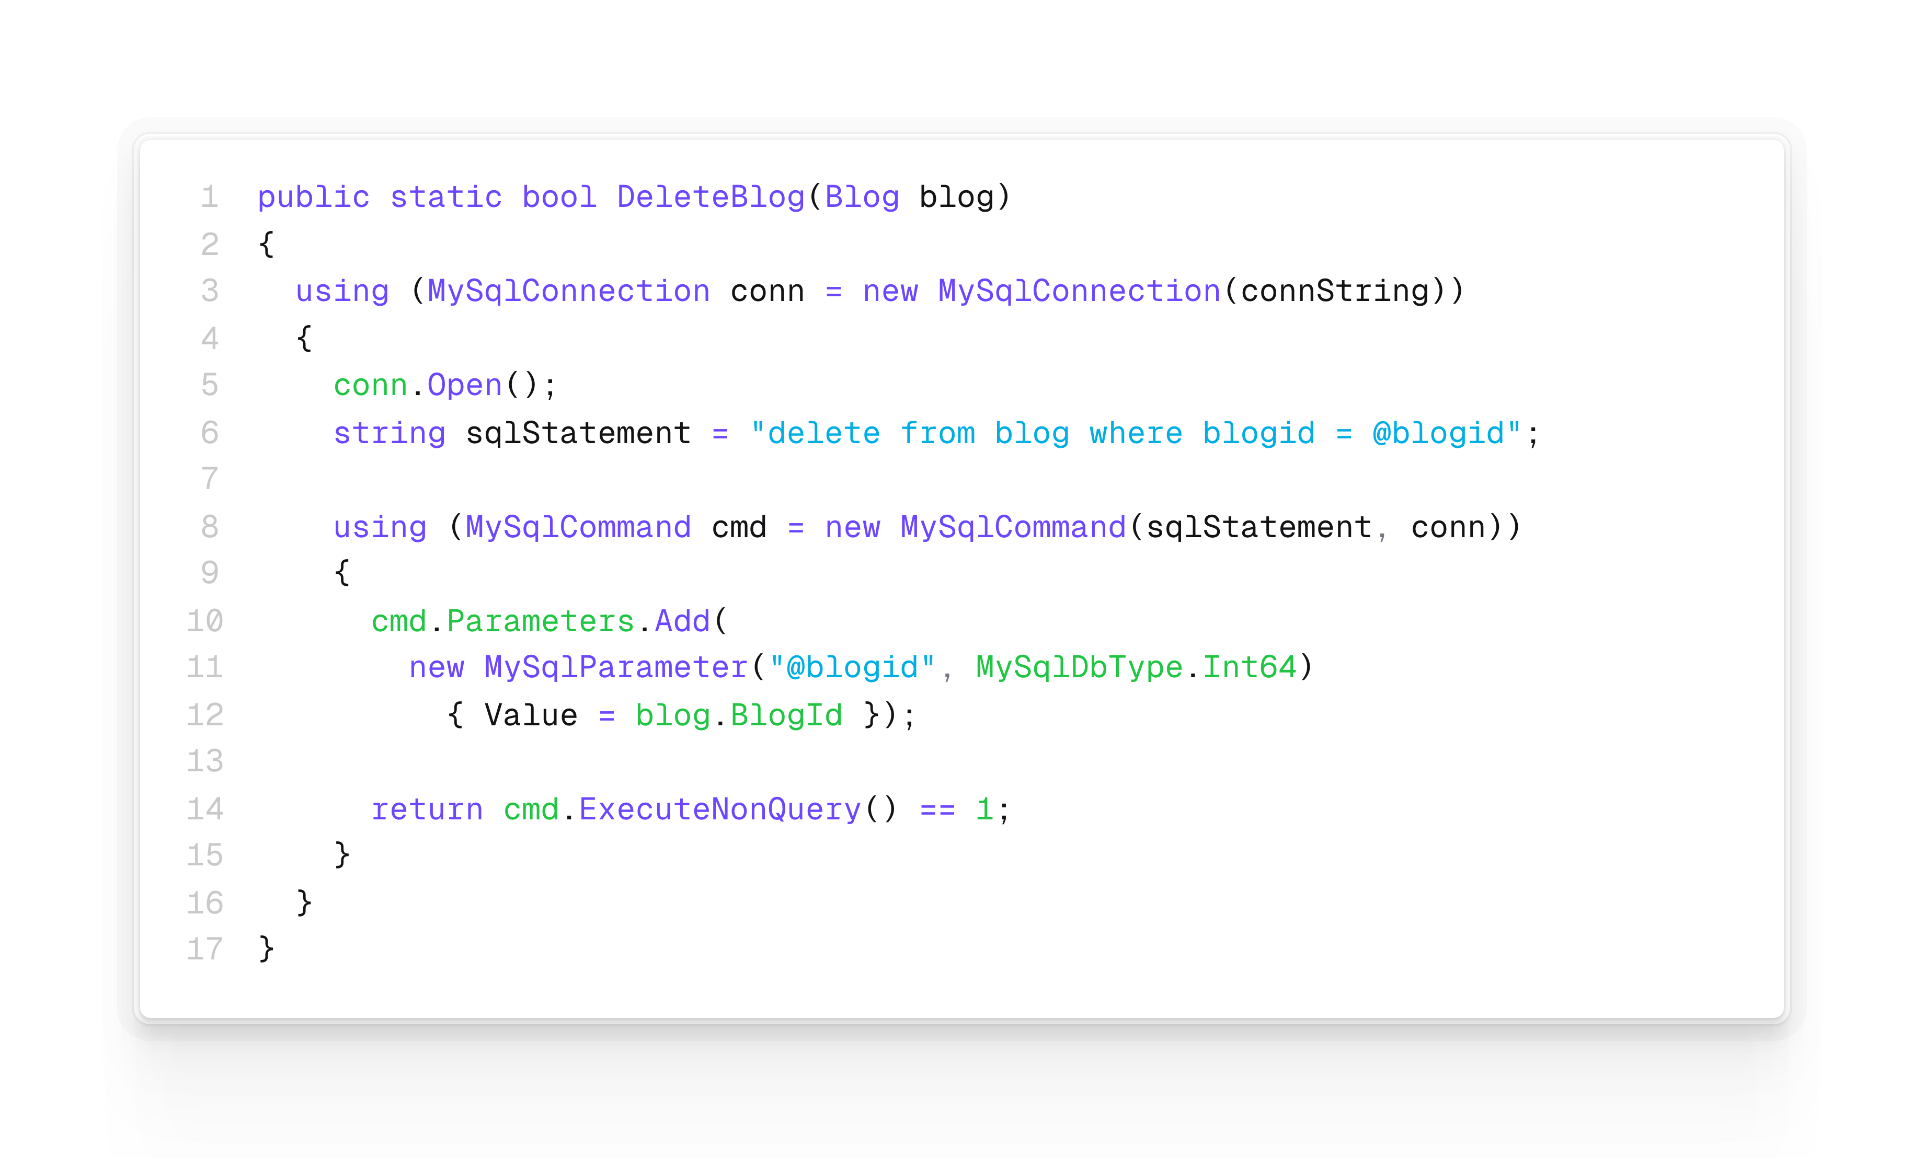
ADO.Net code example: DAL Delete Blog

Slide 29
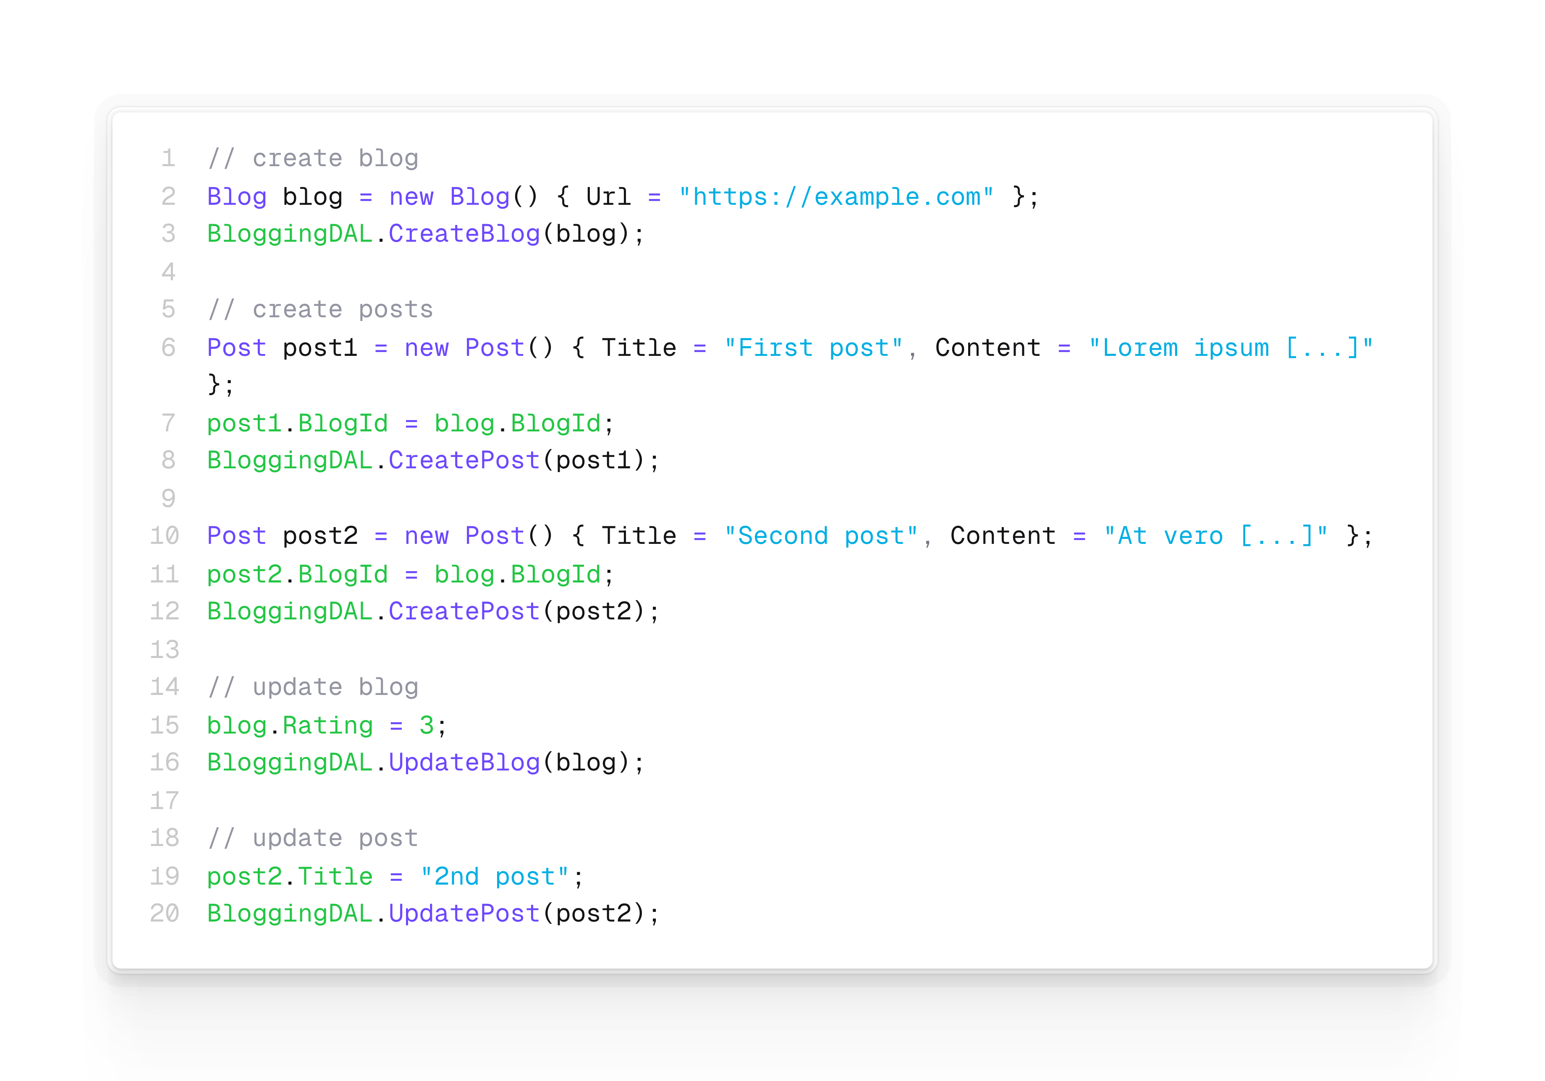
ADO.Net code example: DAL usage

Slide 30
ADO.Net conclusion
No compiler support for SQL-statements (they are just strings)
DAL contains boilerplate code
All Read methods look alike, all Create methods look alike, …
Create and Update methods also look similar
Database must be created and maintained manually
New entity? => 4 methods to be implemented, table to be created
New (datatype for) property? => 3 methods to be changed, table to be altered
New relationship? => foreign key constraint to be created
No transaction support (ie. cannot create a blog and a post in one transaction)
Using nullable value types (ie. int?) is cumbersome
Not really OOP: we use IDs instead of navigation properties
How to implement “all the blogs with rating > x” or “all posts of a specific blog”?

Slide 31
That‘s it ☺
…for now

